Slide 1
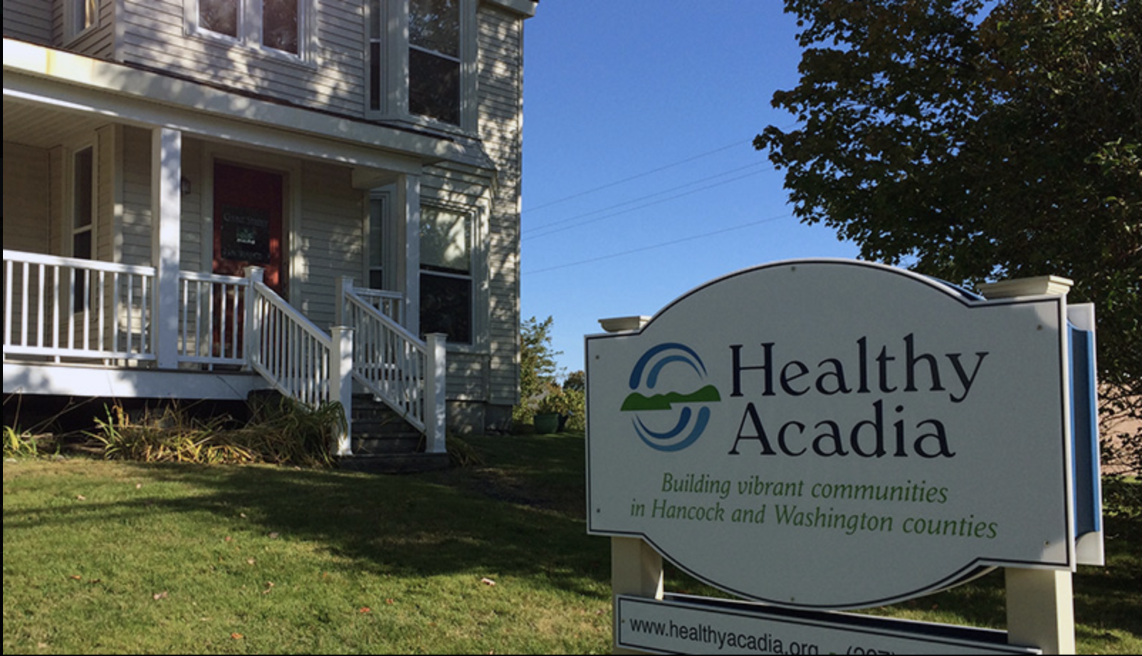
Healthy Acadia
Savannah Steiger
MHR/PSY216
dr lori schneiders
Notes:
For my Community Resource Project I've done HA which is a community center organization stretching between Washington and Hancock County.

Slide 2
Vision, Mission, Service Area
We envision vibrant communities where people thrive and healthful resources are easily accessible.
We empower people and organizations as we build healthy communities together.
We serve Washington and Hancock counties, and we provide additional community health support and leadership across Maine.
Offices in Ellsworth(2), Machias, and Calais
121 Court Street Machias, Maine 207-255-3741

Slide 3
Scope of work
Strong Beginnings
Healthy Food for All
Active and Healthy Environments
Healthy Aging
Substance Prevention and Recovery
Health Promotion & Management
Notes:
This scope of work really details Healthy Acadia’s all age focus. Each of these topics is a hotlink, if you want to follow it for more information. With such diverse offerings the employment positions are wide and unique at HA. There are a lot of community outreach positions, educational positions, health coordinators and several positions in recovery support services. As a student more focused on youth, I interviewed their Youth Engagement Coordinator

Slide 4
“I hear and see our youth in Maine. I once was one of them. They are observant, smart, resilient, and determined.
I am their ally.
I strive to use my power and my voice to support them. I want them to feel powerful, to belong, to feel smart, to feel heard. Youth with power and voice become young adults with power and voice. We need more of them. All of them.”
Downeast Youth Action Team
Corrie Hunkler, LSW, Youth Action Coordinator

