Slide 1
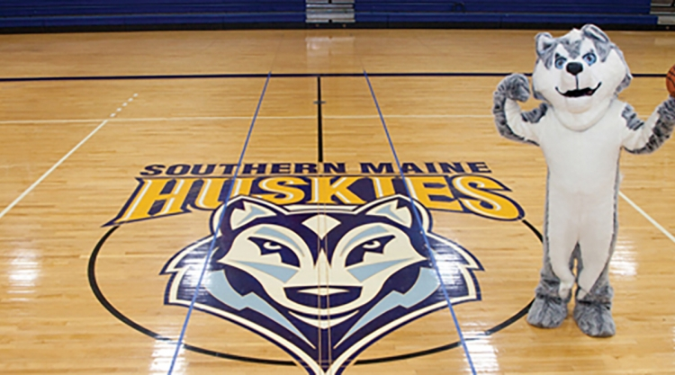
University
of
Southern
Maine
A closer look into the Master of
Science in Counseling Degree-School
Counseling Concentration
Amy Moe

Slide 2
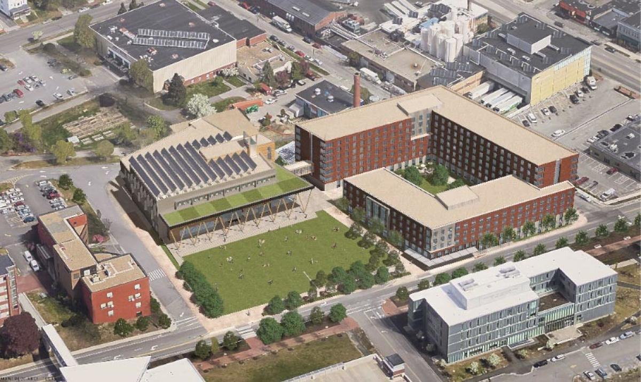
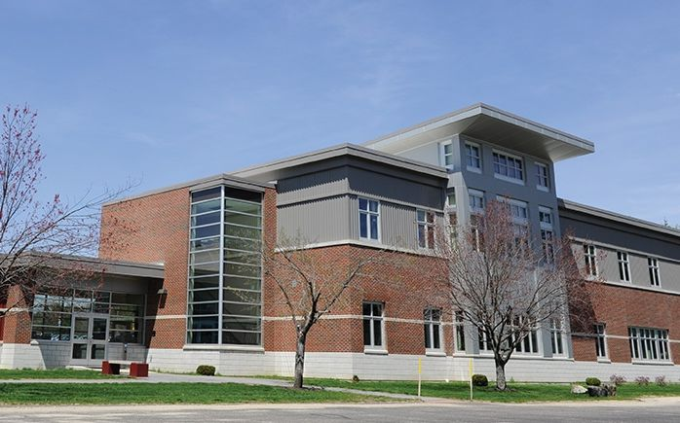
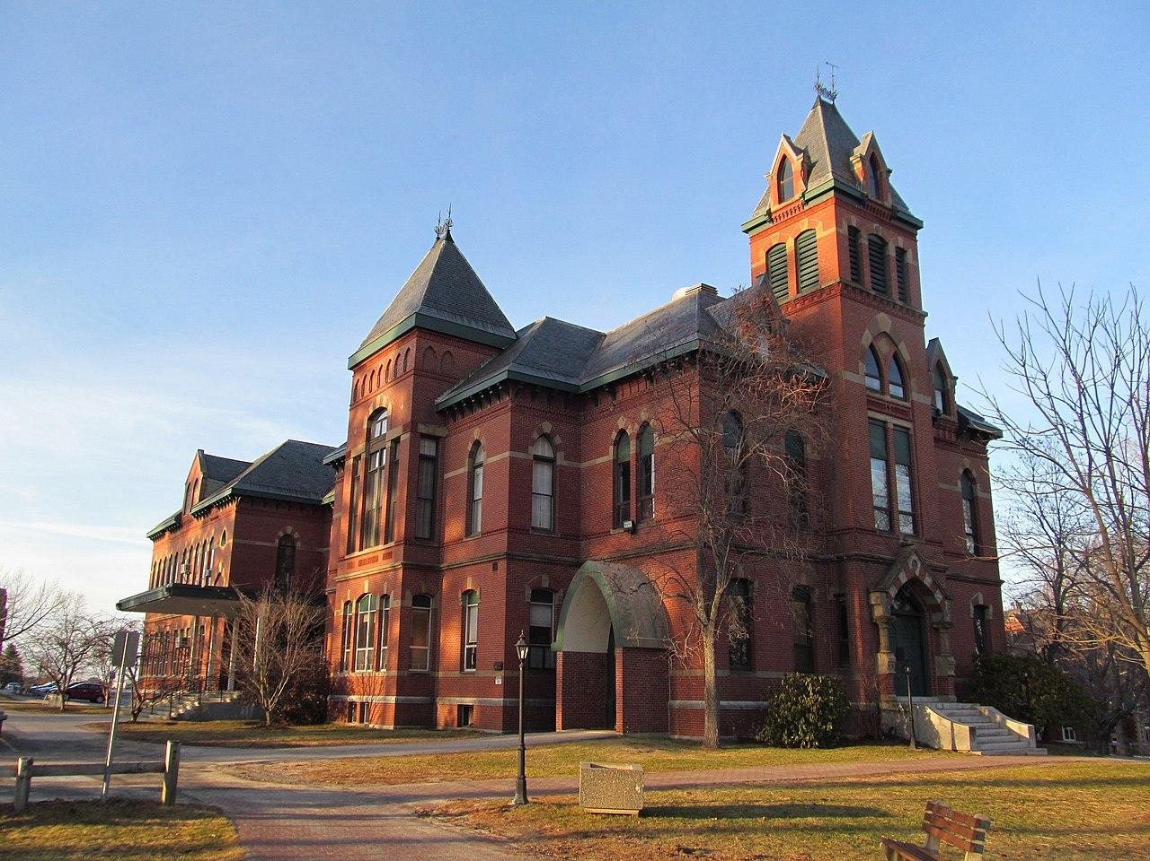
The University of Southern Maine has 3
Campuses: Portland, Lewiston, & Gorham

Slide 3
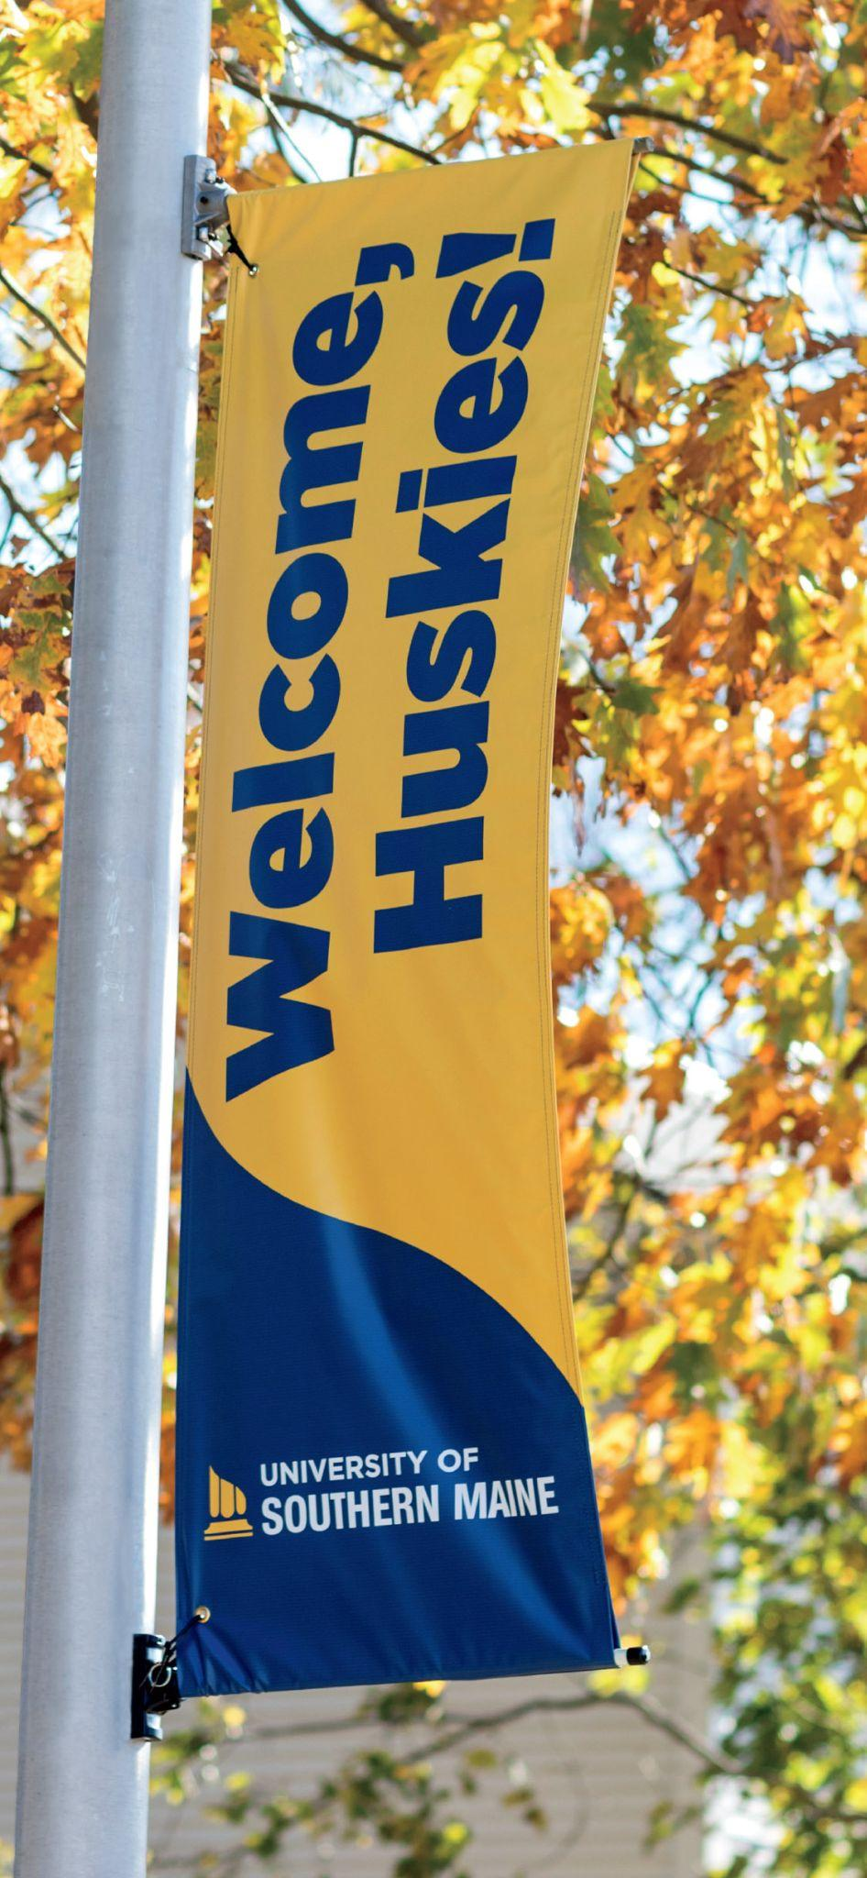
The counselor education program holds accreditation from the Council for the Accreditation of Counseling and Related Education Programs (CACREP)
~ Depending on the MSC concentration, they offer face-to-face, online, hybrid, blended, or any combination of asynchronous and synchronous course delivery.
~ School Counseling Specialty requires 60 total credit hours of coursework:
- 36 credit hours from
Core Courses
- 21 credit hours from
Required
Concentration Courses
- 3 Elective Courses
~ Applicants must have a cumulative grade point average of 2.5 in a Baccalaureate degree program. No GRE or MAT scores are required.

Slide 4
Application
Information:
~Application Fee:
-Waived For
All
Applicants!!!
~ Application Deadlines:
- For Fall Semester Entry: All Applications and Material Submitted by February 15th.
- For Spring Semester Entry: All Applications and Materials Submitted by October 1st.
~ Application Essay IS Required:
-There are 2 specific statements that applicant must address
- Should be around 750 words -or- 2-3 pages combined.

Slide 5
~Tuition costs:
-In State per Credit
Hour= $499.00
-Out of State per Credit Hour= $1,317.00
~ Job Market: -Projected to grow 10% from 2021-2031.
- About 32,000 openings for school and career counselors are projected each year.

Slide 6
Nikki Correa MEd,PhD- Assistant Professor for
School
Counselor
Program
At
USM
~ Academic Degrees:
~ Bachelor of Arts-Psychology, University of Nevada, Las Vegas
~ Masters of Education-School Counseling, University of Nevada, Las Vegas
~ PhD- Counselor Education & Supervision, Oregon State University
~ Research Focus:
~ Suicidality
~ Ethnic/racially Diverse Adolescents
~ Innovative School Counseling Techniques

Slide 7
Thank You
For
Your Time!!
Work Cites:
www.usm.maine.edu
https://www.bls.gov/ooh/community-and-social-service/school-and-career-counselors.htm

