Slide 1
Morning Glory Arts Therapy
Avery Alvarado
MHR 210
Notes:
I chose this because i am an artist myself and have been to therapists who let me to draw or color while we talked and it was really helpful in staying relaxed and letting my thoughts flow

Slide 2
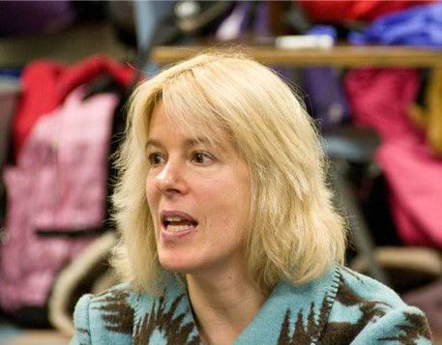
Dr. Maryam Mermey - Expressive Arts Therapist
Notes:
Morning glory arts therapy is a private practice run by Maryam Mermey
Dr. Maryam holds a Ph.D. in Arts, Health and Society, a Master of Arts degree in Counseling Psychology, a Masters degree in Arts Education, and a Bachelor’s degree in Dance and Poetry
She is well known for Designing a bullying prevention model called Transforming the Bullying Cycle Through The Expressive Arts, which focuses on young kids with autism and has been used internationally since 2004
Becoming an expressive arts therapist
Requires a minimum of a Master’s degree in expressive arts therapy, psychology,
fine arts, education, or any related field. It also requires 6 years of education and training.
Internship with 500 hours of supervised clinical work and 50 hours of individual supervisory sessions, or 100 hours of group supervisory sessions, or a combination of the two
On average, expressive arts therapists earn $60k a year
It is a very flexible job which allows for either private practice or work for a company

Slide 3
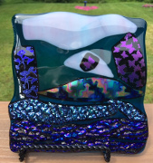
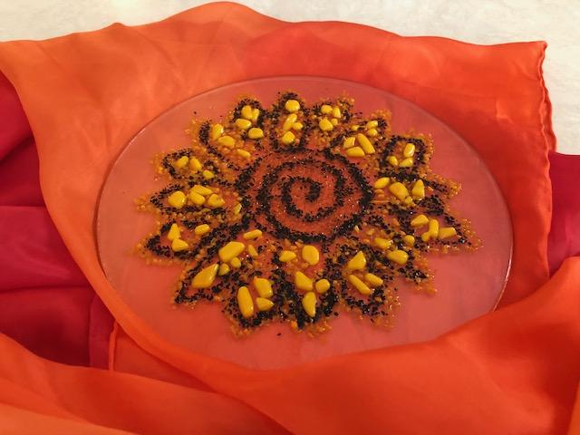
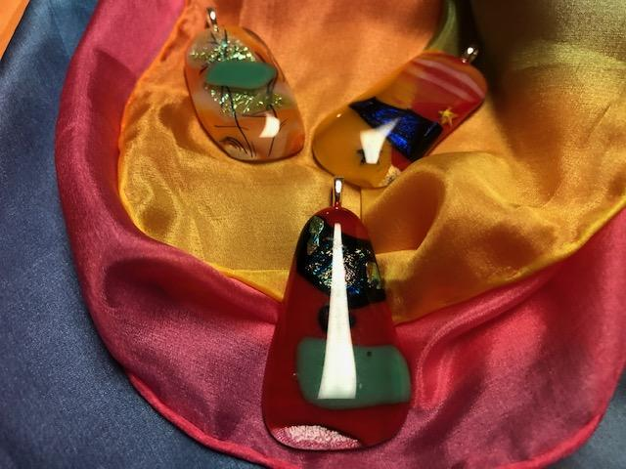
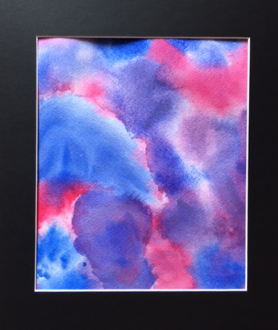
Expressive Art Forms
Visual arts
Fusing glass
Glass staining
Dance
Music
Theatre
Literary arts
Film
Notes:
Expressive art therapy is a form of psychotherapy using artistic and creative modalities to encourage the client's self-expression, insight and personal growth
This differs from art therapy as more art forms are offered
As shown on the slide, morning glory arts therapy offers
Visual arts include painting with watercolor or acrylic, or finger painting for younger children
Literary arts includes creative writing from poetry to story telling
Unlike traditional arts expression, in expressive art therapy, the process of creation is emphasized rather than the final product.
Many of the final products are meant to act as a represention or stand as a reminder of what you learn about yourself in Maryam’s classes
An example of this is how Dr. Maryam emphasizes the metaphor of transformation in glass fusing classes. The definition of glass fusing is literally ‘to transform the glass’. She sees this as a metaphor for transforming your life and mindset. In glass fusing, she also holds classes for jewelry making which are supposed to reflect the client’s “inner jewels.”
The top left picture and bottom left are examples of glass fusing and jewelry making. The top right is a piece from her gallery called the “Sunflower Mandala of Purpose”. And the bottom right is a watercolor done in celebration of healing.
On her website, you can find more pictures of clients work as well as her PhotoPoem exhibit, which she uses to help clients find beauty and passion in their lives.

Slide 4
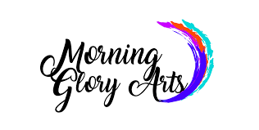
About the Company
Notes:
Serves all ages and Mature children 11 and older are welcome
Maryam offers classes in Individual or group settings and makes accomodations based on each client and their needs
Each session is an hour and a half long, with prices ranging from 50-$150 depending on what the client can affors
Many of her classes are held at the Alfond Center for Health, Augusta
Her office is Located in Manchester, Maine

