Slide 1
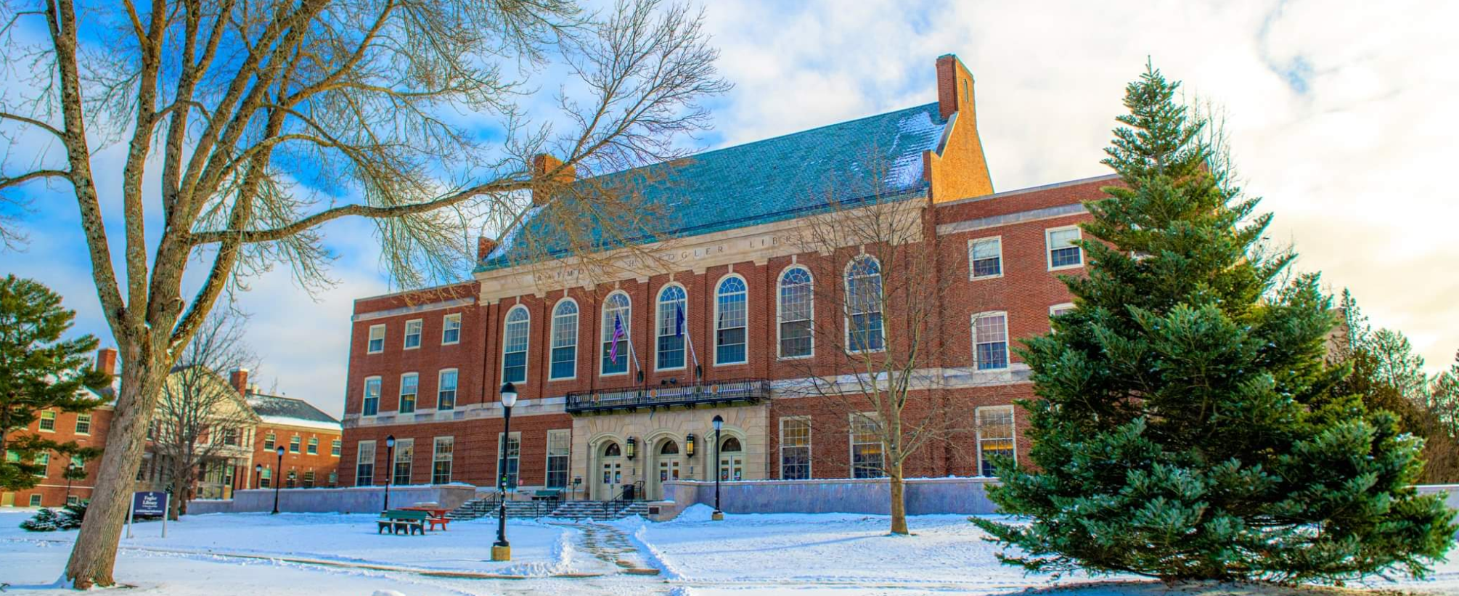
The University of Maine
Clinical Psychology
The University of Maine
Orono Campus
By: Carol Lane
Carol Lane​​
18 Nov 2022

Slide 2
Clinical Psychology Ph.D.
Master’s degree earned in the process of the Ph.D. program​
Five-year on-campus program prepares for careers in research and clinical practice​
60 Credits+ (various practicum credit requirements)
Follows the scientist-practitioner model:
Trains to work with individuals across the lifespan, but also offers specialized emphases in child clinical and clinical neuropsychology
Train in psychological assessment, psychotherapy, and consultation​
Fully accredited by the American Psychological Association (APA)

Slide 3
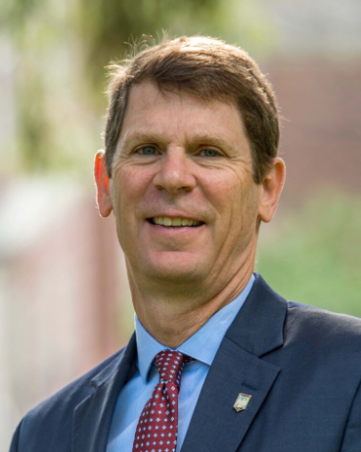
Meet the Director of Clinical Training
Dr. Jeffery E. Hecker, Ph.D.​
Professor Jeffery E. Hecker Director of Clinical Training
Research focus: Forensic Psychology Sexual Offending
Psychology Department 382 Williams Hall Orono Campus

Slide 4
APPLICATION PROCESS
Research Your Advisors 2-3 Semesters Before Applying *So You Will Know if Your Advisor with Similar Interest is Taking Students
Submit Clinical Psychology Grad School Application by Dec 1 *No Fee
Remote Interviews in Late January
Submit General Application No Later Than Dec 1 for Fall Admission *$65 Fee *Essay Required *No GRE /MAT Required
Misc. Paperwork: *Apply for Financial Aid/Housing *MaineCard ID *Math Exam *IZ Records *College Transcript *Buy Books
Pay $175 Enrollment Deposit by May 15

Slide 5
Cost
COST VS. RETURN
Tuition 11,940 Other Fees 346 Room & Board 11,856 Books & Supplies 1,000 Travel & Misc. 2,270 YEARLY COST: $27,412 x FIVE YEARS = $137,060
Return
Average Annual Salary for a Clinical Psychologist in Maine: $118,651* *According to indeed.com, Salaries
GRADUATE SCHOOL PRESENTATION – LANE 5

