Slide 1
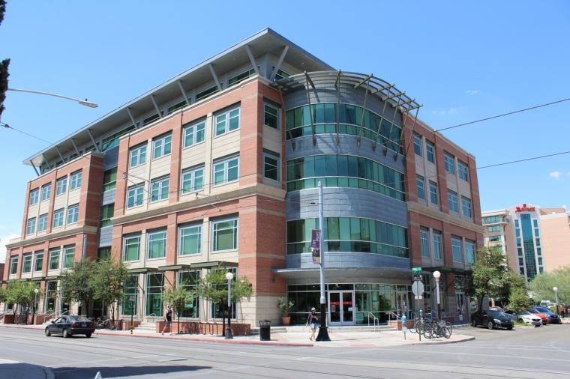
University of Arizona
November 17th, 2021
Hailey Wood
Edition: 001
Masters in Journalism

Slide 2
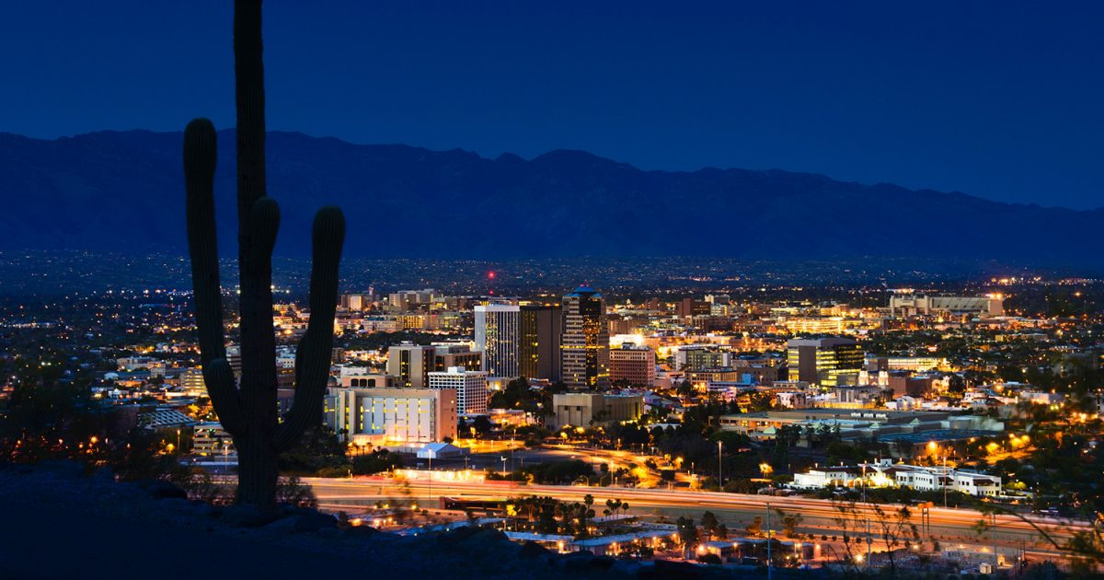
Tucson, Arizona
November 17th, 2021
Newsletter
Edition: 001
The school of journalism is in Tucson, which has a population of 541,482. Tucson is the second most populated city in Arizona.

Slide 3
Suggested schedule
33 Credits are required to earn a masters in journalism
First Year
Fall Semester
JOUR 506 Introductory and Advanced Reporting (3 units)
JOUR 507 Reporting with Multimedia (3 units)
JOUR 508 Journalism Theory and Practice (3 units)
Spring semester
JOUR 509 Media Law and Ethics (3 units)
JOUR 589 Research Methods (3 units)
Elective: Professional skills course (3 units)
Second Year
JOUR 590C or 590F (School Media; choose one) (3 units)
JOUR 909 Project or JOUR 910 Thesis (3 units)
Electives (9 units)

Slide 4
Applying
November 17th, 2021
Newsletter
Edition: 001
● There is a 90$ fee for applying to graduate programs at the University of Arizona
● You apply using UA’s gradapp program
● Application deadline for the fall semester is Feb. 15 2021 and spring semester due by Sept. 1st
It is evident that you need to apply to these programs much in advance, so preparation is required

Slide 5
Other application things
There is no testing required for graduate programs at the University of Arizona. If it is required it is specified for that course, for mine it was not.
You cannot receive a degree for my program through distance learning. You have to attend campus to complete this degree.

Slide 6
Tuition
Monday 01/02/2020
Newsletter
Edition: 001
At 34,800$ a year without considering financial aid, it would cost 69,600$ or more to earn a Masters in Journalism from UA. There are fellowships/scholarships/etc. To apply to and they provide some of those on their website.

Slide 7
Job Market
Monday 01/02/2020
Newsletter
Edition: 001
According to the US Bureau of Labor Statistics, Employment in media and communication occupations is projected to grow 14 percent from 2020 to 2030, faster than the average for all occupations, and will result in about 151,500 new jobs.
Despite the statistics from the BLS, other sources accurately point out that the field is becoming more competitive and success in the field will require a lot of skill and the ability to get a lot of work done in a quick turnover time.

