Slide 1
Identity in a diverse society
Crossing Borders
International Module on Participation and Citizenship
9-11-2010
Dr. H.J. Kuipers / INHolland University
1

Slide 2
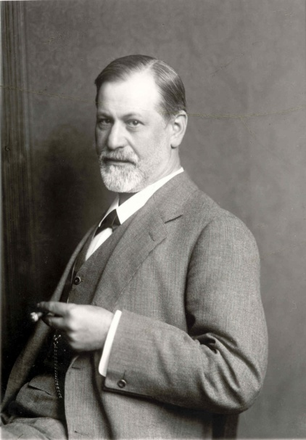
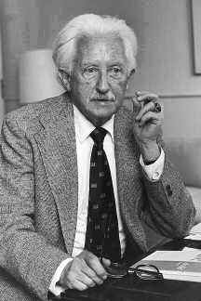
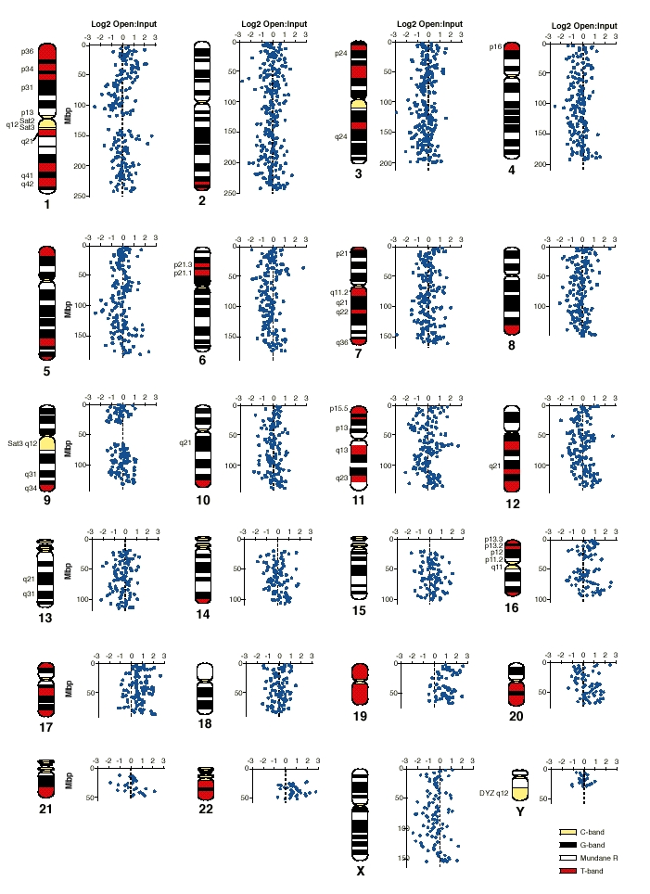
Identity?
Remaining the same over time: continuity
Showing particular characteristics in every situation: coherence
In our genes or acquired gradually?

Slide 3
My point
From | To
Traditional view | Alternative view
Psychological orientation | Sociological orientation
Identity as remaining who one is | Identification as a process
Looking for the core | Looking for relations
Less useful to study diversity | More useful to study diversity

Slide 4
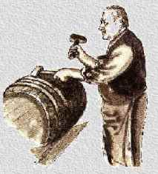
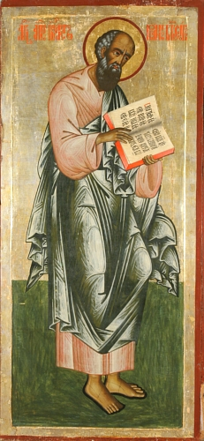
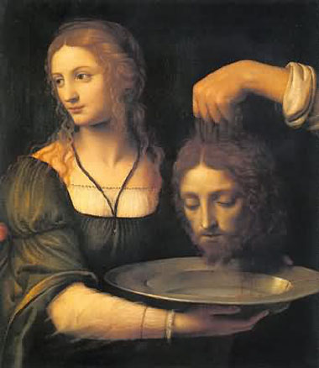
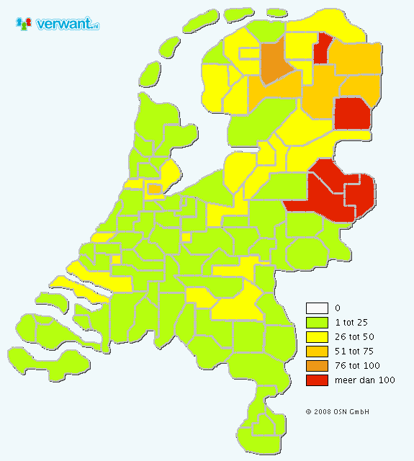
What ‘s in a name?

Slide 5
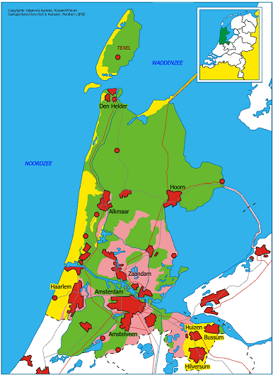
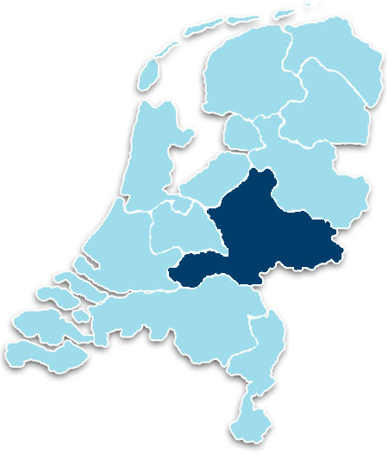
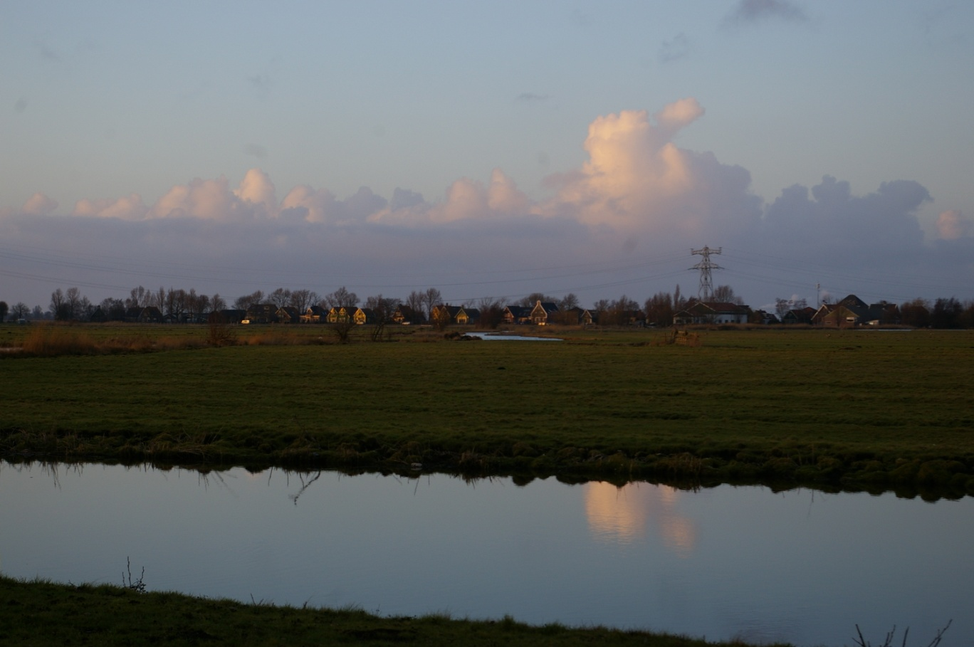
Domicile and place of birth

Slide 6
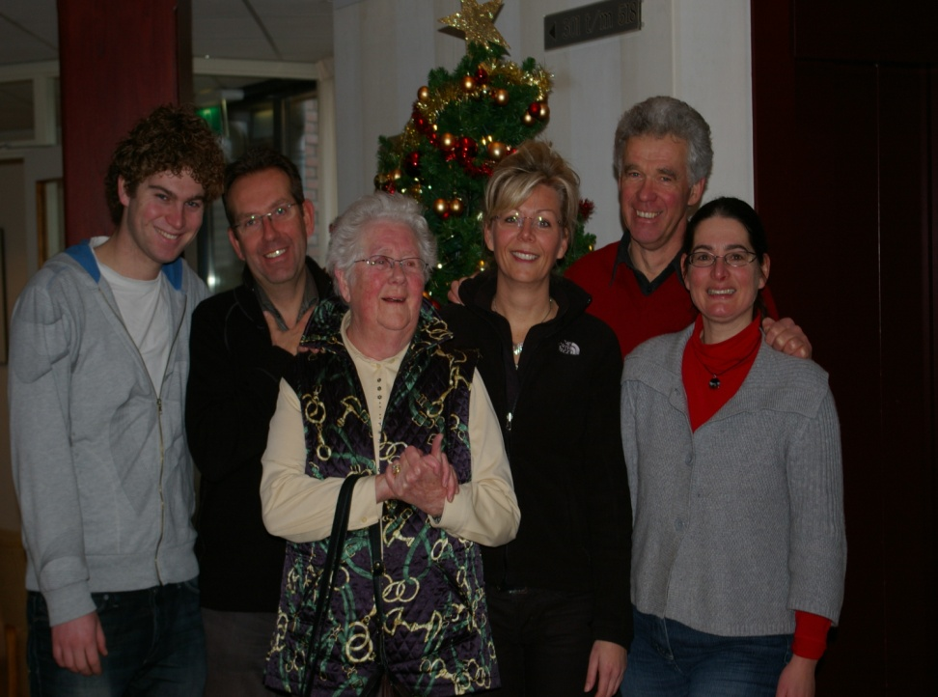
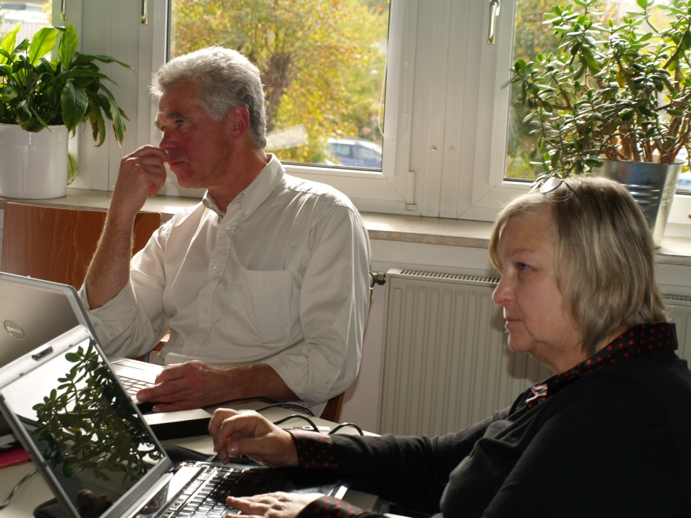
Social differentiation
Private life and family
Professional life

Slide 7
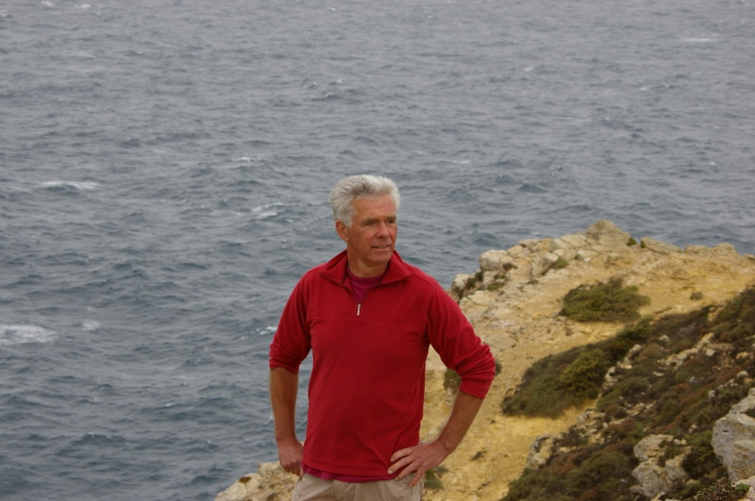
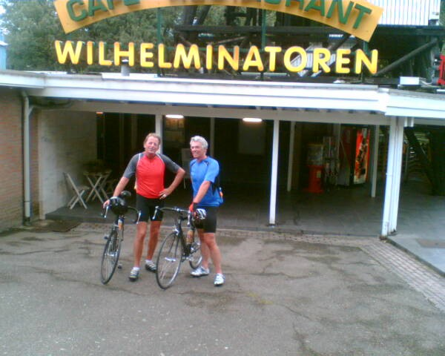
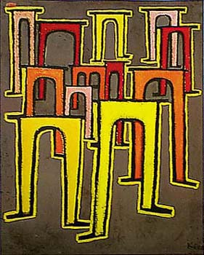
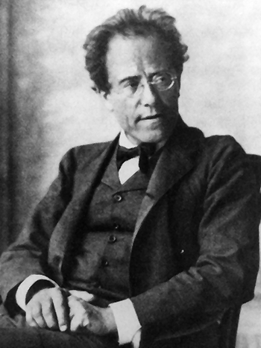
And spare time

Slide 8
Some sociological conslusions
People identify themselves by telling who, where or what they belong to
Social differentiation and mobility influence the way we identify ourselves
When we identify ourselves we use the words ‘I’ and ‘me’
When others identify us they will use the words ‘you’, ‘he’ or ‘she’

Slide 9
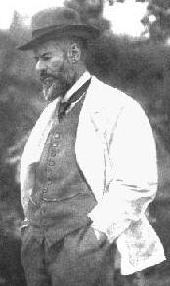
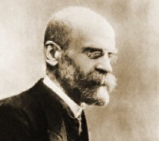
Classical sociology
Division of labor causes social differentiation
Mobility is a result of social differentiation
Spheres of life will be progressively separated
Each sphere has distinctive rules
Émile Durkheim
(1858-1917)
Max Weber
(1864-1920)

Slide 10
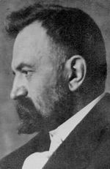
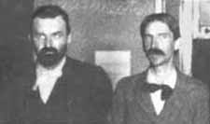
George Herbert Mead
(1863-1931)
Others identify us before we identify ourselves
We believe that we know how others identify us
We think we know what we are really like

Slide 11
Identity and the stories we tell
In the stories we tell we identify others (you, he, she, they)
In the stories we tell we identify ourselves (I and me)
We tell stories that relate to other people, but tell a lot about us as well

Slide 12
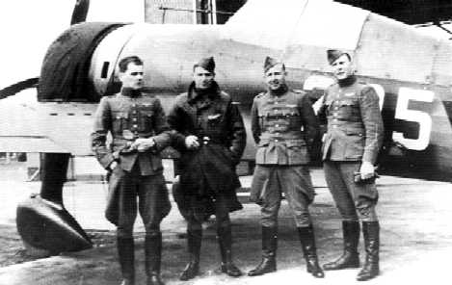
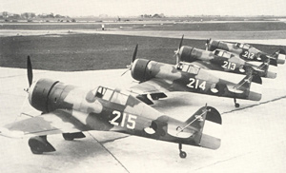
My uncle in May 1940
(before I was around)

Slide 13
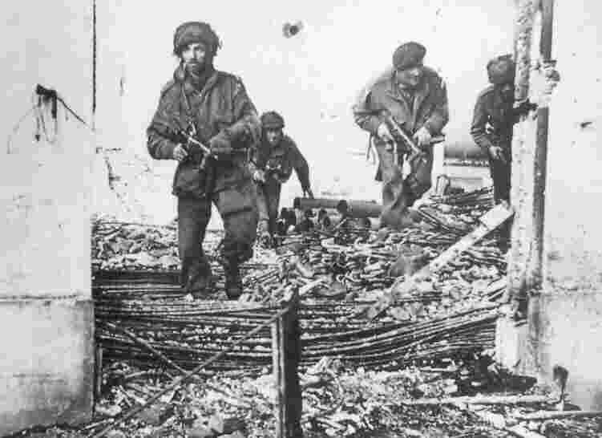
My secondary school near Arnhem in September 1944
(again, before I was around)

Slide 14
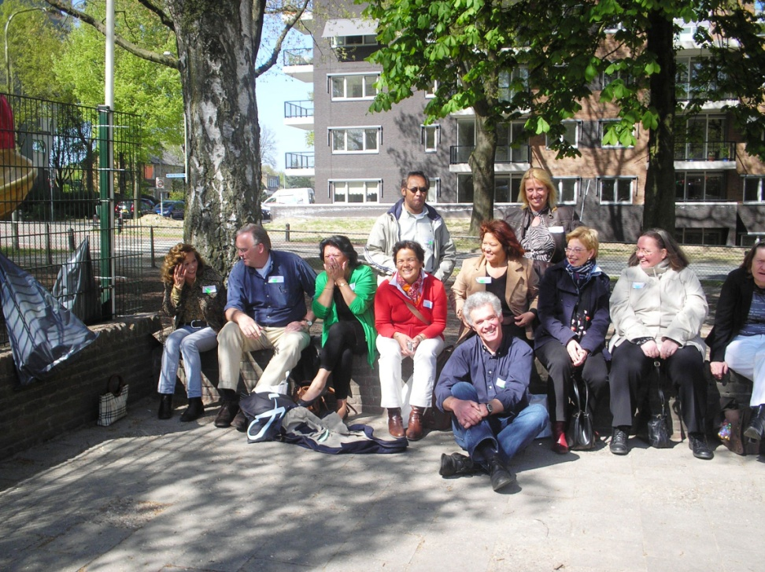
A group of eleven from my primary school during a recent reunion
Five persons from an orthodox protestant family
Four persons from the former Dutch colony Indonesia
One person from the former Dutch colony New Guinea

Slide 15
Provisional conclusions about identity in a diverse society
Diversity is not but a recent phenomena, but part of modernity
Identity is not a person’s original core, but an intricate process
A person’s identity is constructed and reconstructed in social interaction

