Slide 1
The University of Vermont
Burlington, VT
Graduate School Counseling Program
By : Mila Long-Frost

Slide 2
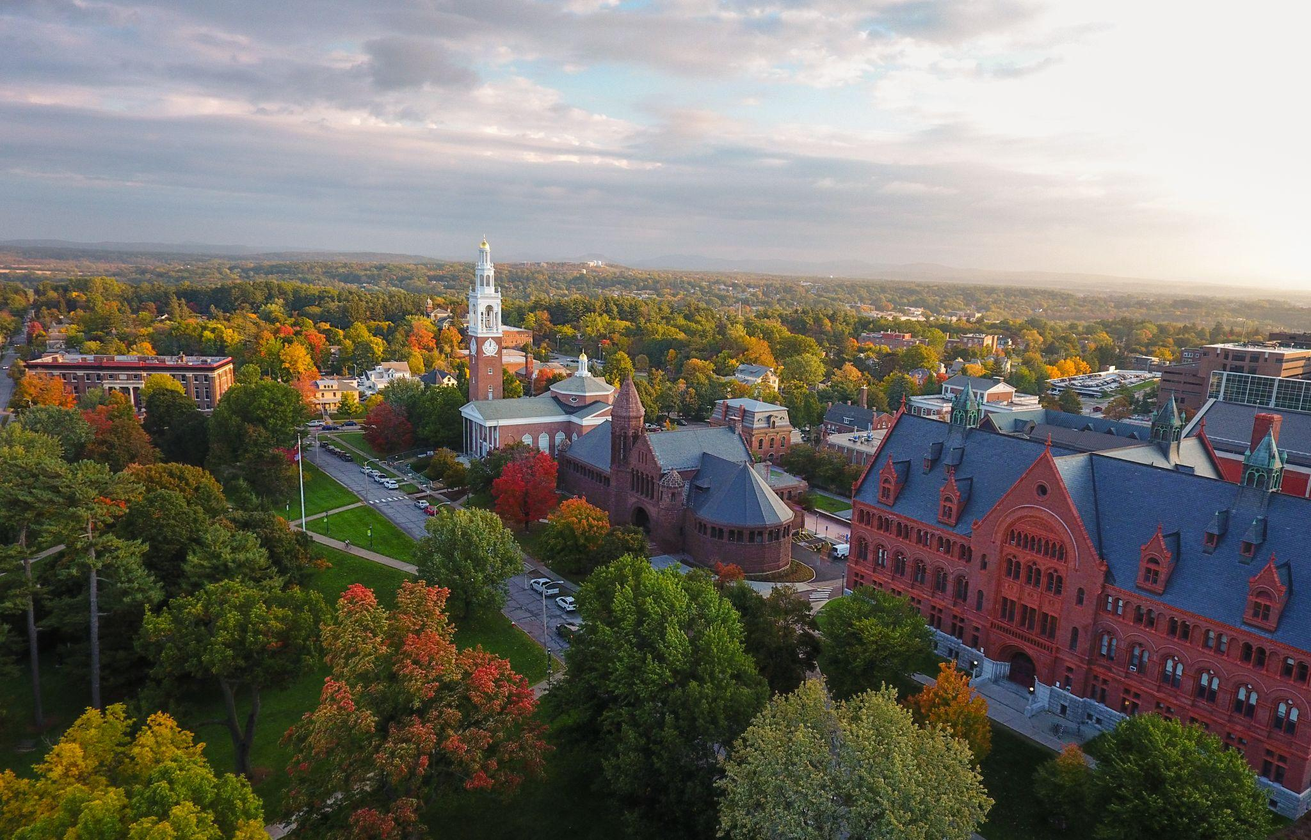
Admissions:
Deadline: Fall Enrollment: January 15th
Application Fee - $65 for Master’s/Doctoral Studies
Basic Requirements: Writing sample, references, + statement of purpose
UVM’s graduate degree in school counseling does not require GRE scores!

Slide 3
Program Details- UVM’s Graduate School Counseling Program
60 credit-hour CACREP accredited program
Core delivery of instruction is in person classes, with a minimal online aspects

Slide 4
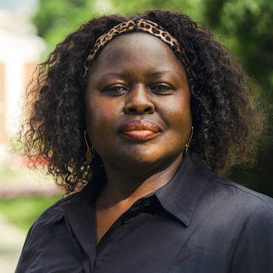
Faculty Focus Spotlight Job Market with Degree
A Masters in School Counseling opens the door to a variety of career paths. Listed below are some of the more common with this skill set and degree:
School Counselor
Career Counselor
Family/Marriage Therapist
Social Worker
Substance Abuse Counselor
Mental Health Counselor
Many more career fields can be explored/entered with further certifications/education
Jane Okech
Professor of Counseling Education
Research/Areas of Expertise
Clinical supervision
Diversity, access and equity
Ethics
Group co-leadership
Group psychotherapy
Mental health
Multiculturalism
Social justice

Slide 5
UVM’s Graduate Tuition
Sources:
UVM homepage. University of Vermont. (2022). Retrieved November 20, 2022, from https://www.uvm.edu/
Job's for Master's Degree in School Counseling. Learn.org. (2003). Retrieved November 20, 2022, from https://learn.org/articles/jobs_for_a_masters_degree_in_school_counseling.html
University of Vermont, 2022

