Slide 1
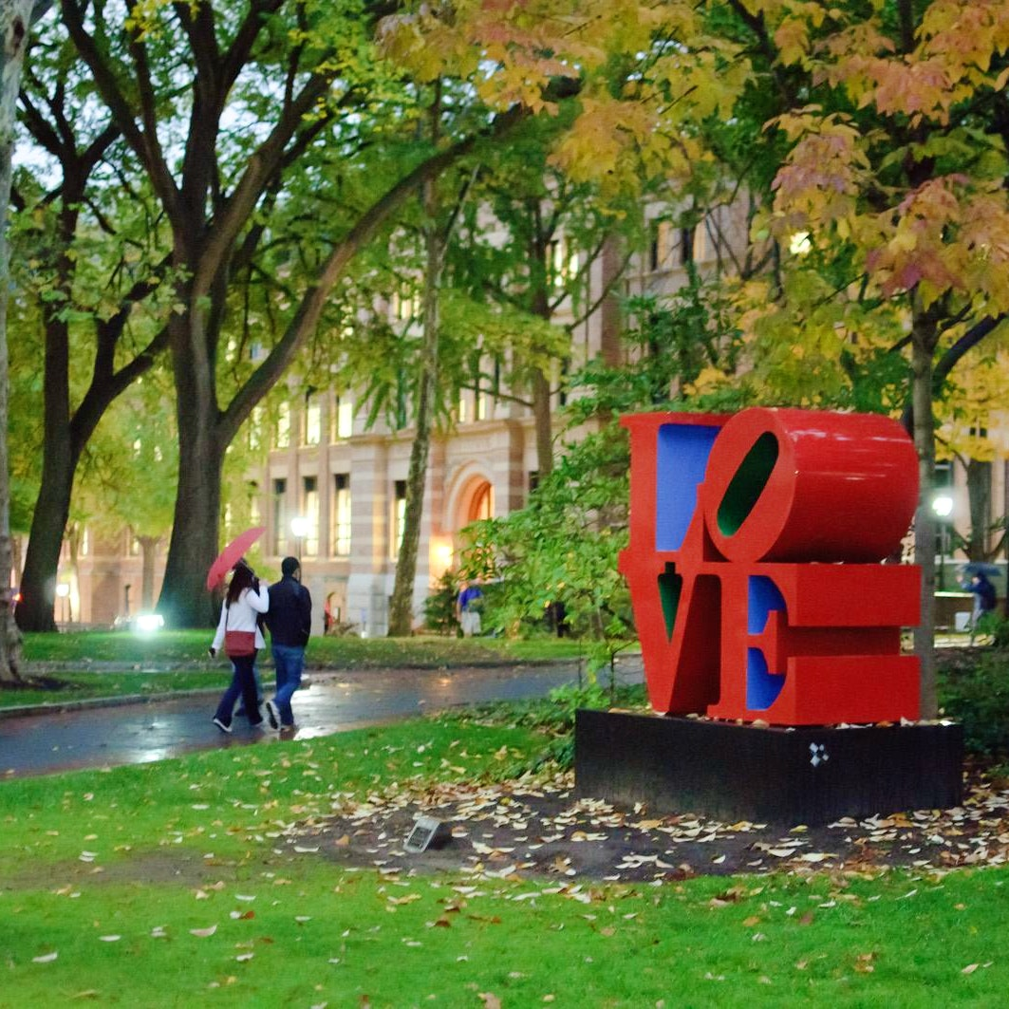
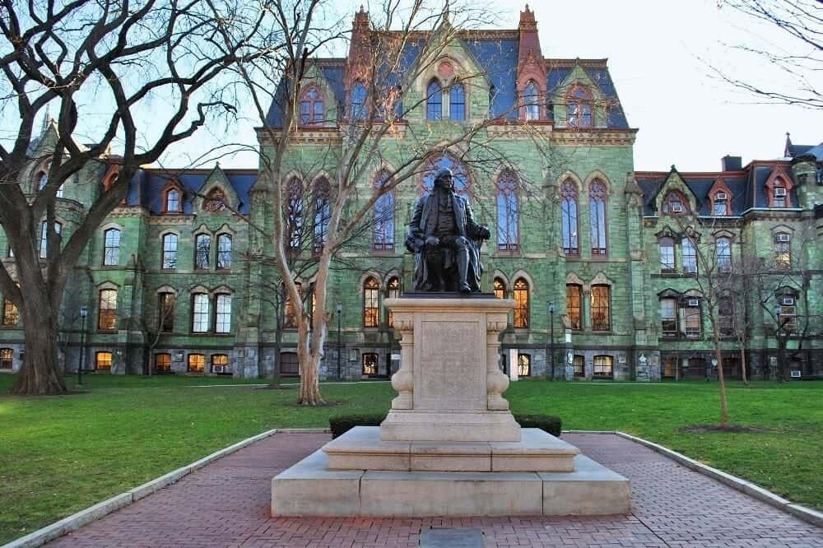
UNIVERSITY OF PENNSYLVANIA MFA, FINE ARTS

Slide 2
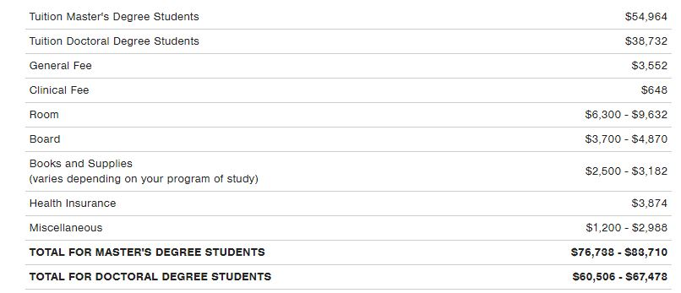
UNIVERSITY OF PENNSYLVANIA
Philadelphia, PA
Upenn is regionally accredited by Middle States Commission on Higher Education

Slide 3
APPLYING AT UPENN GRADUATE SCHOOL
There is a $90 non-refundable application fee, which can be waived under some conditions.
Application window opens September 15th and closes on February 1st .
The decision is released on or before April 1st .
Good news, the GRE is not required but recommended. Also, there is no minimum score. If you choose to submit it, the Upenn code is 2888.
Upenn requires an essay. There is no specific topic, but a format and information expected in the essay is shared on their website.

Slide 4
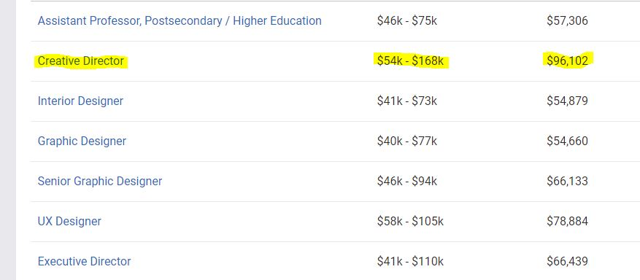
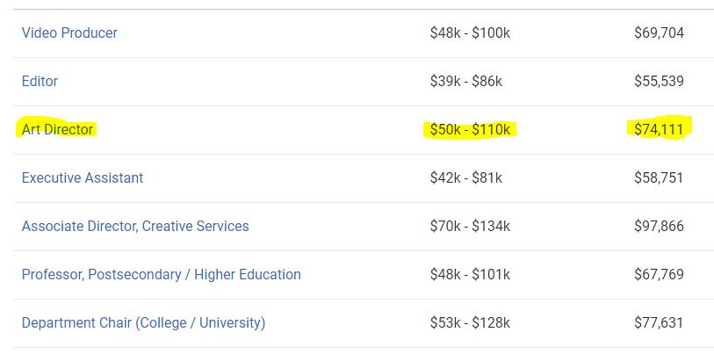
MFA, Fine arts
MFA requires 19 credit units;
8 in studio, 4 in critique, 2 in seminar and 5 in electives either in the Fine Arts or different major.
MFA is both on campus and online. For studio courses, the student is expected to be on campus. For the remaining classes, they are mixed with both on campus and online classes.

Slide 5
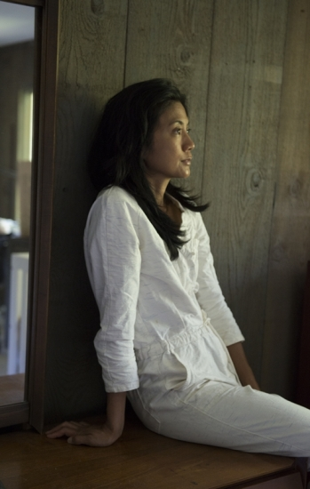
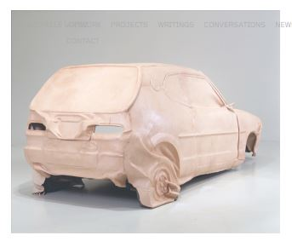
Mfa faculty
Michelle Lopez is the Carrafiell Assistant Professor in Fine Arts and a multimedia artist, known for her rigorous conceptual practice and boldly experimental approach to processes and material. Her installations and sculptural works are grounded in research on the iconography of cultural phenomena.
Michellelopez.com
Boy,
1999
Michelle Lopez,
Carrafiell Assistant Professor

