Slide 1
Special Education (MA) - Applied Behavior Analysis
Psychology and Community Studies, University of Maine at Machias
COE 313
Dr. Lori Schnieders
Sarah Lazaro

Slide 2
ABOUT THE UNIVERSITY OF ARIZONA
Location: Tucson, Arizona
The University of Arizona offers a wide variety of academic programs, many of which are among the nation’s best. Students can choose from more than 300 undergraduate and graduate degrees through 20 colleges and 23 schools on four campuses.
Enrollment: 49,471 Students (Undergraduate 38,528 | Graduate 10,943)

Slide 3
Program/Degree
Special Education (MA) - Applied Behavior Analysis
Rigorous fully online program.
Prepares students interested in working with people with problem behavior, and/or delays in communication, social, and adaptive skills.
This program prepares students to provide evidence-based services in applied behavior analysis in clinical, school, and home setting.
This program is comprised of 36 units and includes the seven courses (21 units) verified by the Behavior Analyst Certification Board (BACB) that provides the didactic requirements to take the Board Certified Behavior Analyst (BCBA) examination.
This program does not lead to teacher certification, but provides a path to Board Certification as a Behavior Analyst (BCBA)”.
(Special Education (MA) - Applied Behavior Analysis Graduate Program of Study at the University of Arizona, n.d.)

Slide 4
Admission Requirements
Essay- Personal Statement an autobiographical essay - 1-2 pages, double spaced
Bachelor's degree from an accredited college or university
Minimum 3.0 grade point average
Three letters of recommendation.
Transcripts of all previous college work from each college or university previously attended
No minimal score requirement for the GRE or MAT
Application Fee
$85
Admission Application Deadlines
Admission Term: Fall - July 15
Admission Term: Spring - November 15
Admission Term: Summer - April 1
Admissions Contact ~ Elizabeth A Pina ~ 520-621-5164
(Special Education (MA) - Applied Behavior Analysis Graduate Program of Study at the University of Arizona, n.d.)

Slide 5
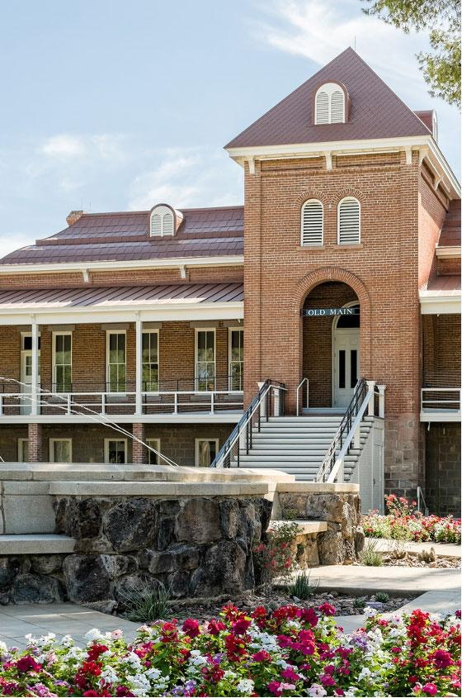
Tuition
No out-of-state tuition
$653 per credit hour
Pay per credit to learn at your own pace

Slide 6
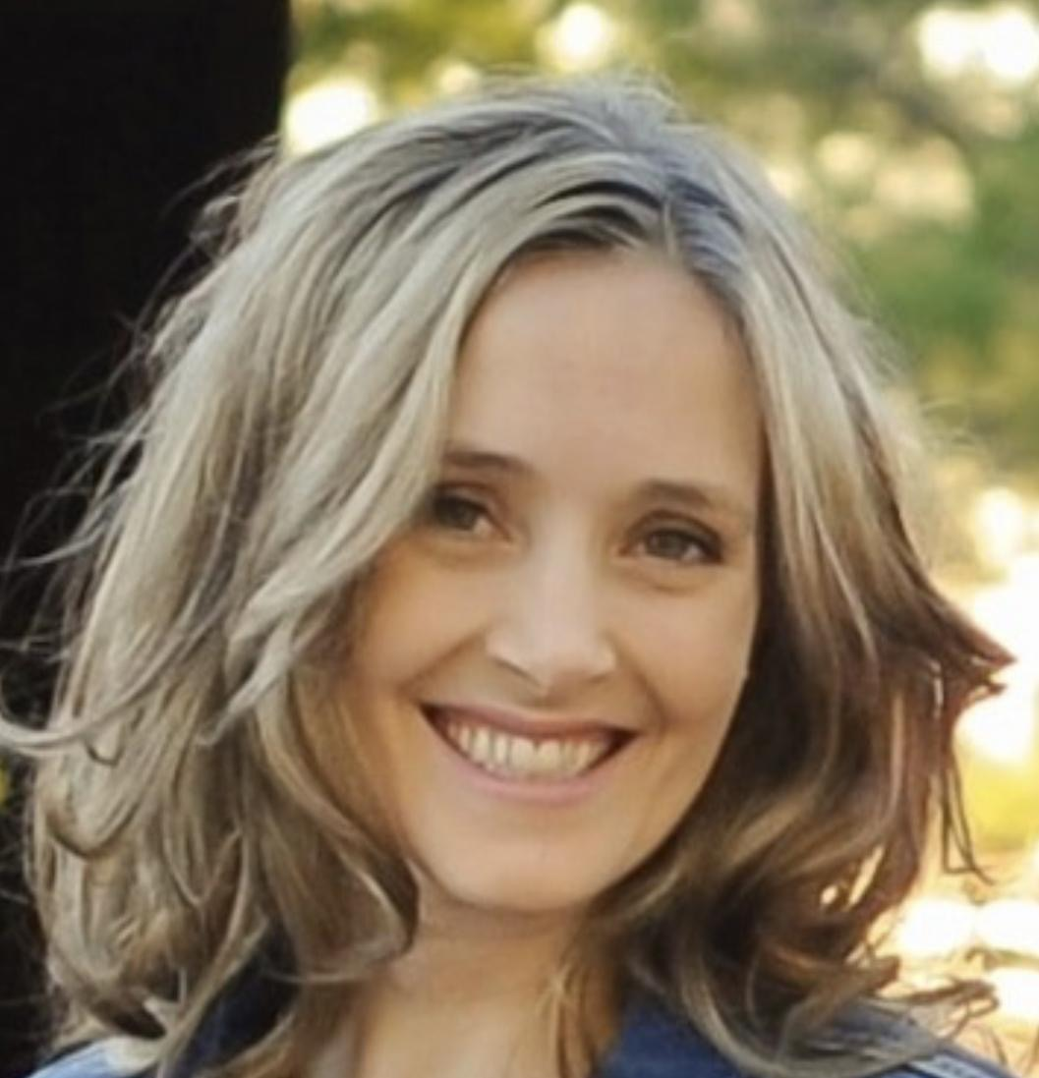
Rebecca Hartzell, Program Director Ph.D., BCBA-D hartzell@email.arizona.edu
Rebecca Hartzell is Assistant Professor of Practice in the Special Education Program and Director of the MA program in Applied Behavior Analysis. She earned her doctorate in special education with an emphasis in autism and applied behavior analysis. Dr. Hartzell teaches courses, advises, and supervises students pursuing board certification in applied behavior analysis and provides clinical support to parents and families of children with neurodevelopmental disabilities. She is the author and co-author of peer-reviewed journal articles focused on social-skills interventions and inclusion.
(Rebecca Hartzell, Program Director | Behavior Analysis, n.d.)

Slide 7
What is the job market for this degree?
“Demand for behavior analysts is increasing: Over the past 12 years, demand for behavior analysts holding BCBA or BCBA-D certification has increased by 5,852%. Annual nationwide demand for individuals holding BCBA/BCBA-D certification has increased each year since 2010, with a 38% increase from 2020 to 2021. Demand was highest in 5 states in 2021 (ordered from most to least): California, Massachusetts, Texas, Florida, and Illinois. These 5 states account for 48% of the recent demand for behavior analysts, with California alone accounting for 24% of the 2021 demand.”
(Behavior Analyst Certification Board, 2022, p.2)

Slide 8
References
Behavior Analyst Certification Board. (2022). US employment demand for behavior analysts:
2010–2021. Littleton, CO: Author.
Rebecca Hartzell, Program Director | Behavior Analysis. (n.d.). Behavioranalysis.arizona.edu. Retrieved
November 22, 2022, from
https://behavioranalysis.arizona.edu/person/rebecca-hartzell-program-director
Special Education (MA) - Applied Behavior Analysis Graduate Program of Study at The University of Arizona.
(n.d.). Grad.arizona.edu. Retrieved November 22, 2022, from
https://grad.arizona.edu/catalog/programinfo/SPECMAABA
‌

