Slide 1
Nonprofit/NGO Leadership, MSNPL
By Jessalyn Gove

Slide 2
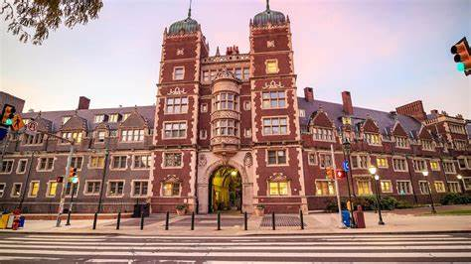
34th & Spruce Street, Philadelphia, PA 19104
Tuition - $69,600
10 required courses

Slide 3
Application details
Deadline -
On campus - January 15th
Online- February 15th
Fee- $65
GRE scores are not required
TOEFL or IELTS scores required for international students

Slide 4
Essay
3 prompts
1) Write a short thank-you note to someone you have not yet thanked and would like to acknowledge. (We encourage you to share this note with that person, if possible, and reflect on the experience!) (150-200 words)
2) How will you explore community at Penn? Consider how Penn will help shape your perspective and identity, and how your identity and perspective will help shape Penn. (150-200 words)
3) Considering the specific undergraduate school you have selected, describe how you intend to explore your academic and intellectual interests at the University of Pennsylvania. (150-200 words)

Slide 5
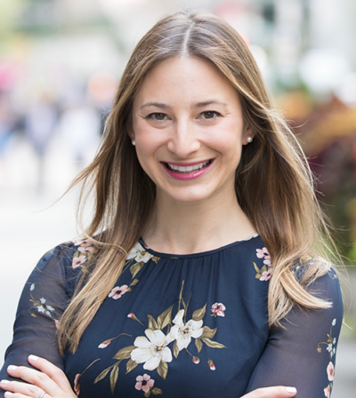
Faculty Member
Elizabeth Abel
Raised half a billion dollars collectively
“Fundraising & Philanthropy: The Donor Journey”
School of Social Policy and Practice Alumni Hall of Fame-2022

Slide 6
How can you use this degree?
Outreach Coordinator Jobs
Grant Writer Jobs
Development Jobs

Slide 7
MSNPL - School of Social Policy & Practice (upenn.edu)

