Slide 1
University of Cincinnati
Grad School Presentation
Abigail Frank

Slide 2
To start this presentation off, I would like to say that all of these findings are based on a program for Social Work MSW.
The first question I would like to answer, is “How many credits are required?”. The answer to this is between 34-60 credits to complete.

Slide 3
Questions About applying:
what is the timeline for submitting an application?
~The application to apply for this program opens in September for the following year, and the deadline to apply is February 15th.
Is there a fee for applying to this program?
~There is a fee you have to pay, and it is Sixty-Five dollars. This is not including if you get excepted, which if you do, you have to pay an additional Hundred dollars.
How much is tuition?
~for a student going part-time in the graduate level program it would be between 724.00~1,311.00 per semester.
For full time student this would be between 7,234.00-13,105.00.

Slide 4
Location and Campus Questions:
Where is the university Located?
~The university is located in Cincinnati Ohio, although there are notably four different campuses to this college.
Is there a distant component or are all classes on campus?
~There is a distant component, considering there are four different campuses
Is the program Accredited?
~Yes, the program is accredited by the CSWE

Slide 5
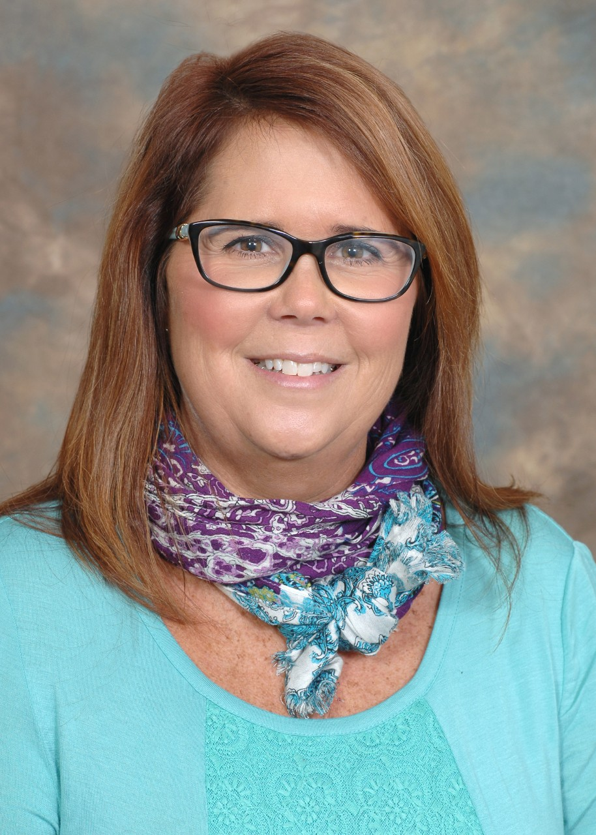
Faculty Member:
Name and job title:
Xan Boone,
She is the current program coordinator.
Research focus:
She is currently working on training child social workers, and has gained a grant as of this june.

Slide 6
Last Questions:
Is an essay required, and do they give you a topic?
~ It asks that you give a personal statement, but does not require an essay.
What is the job Market for this job with a degree?
~ Currently for the job of a licensed social worker, there are always positions opening up, so it is a highly wanted position.

Slide 7
Thank you all so much for listening to my presentation, I tried to make it quick for all of you. Have a great rest of your day and I hope you understand the program better!

