Slide 1
University of Colorado Boulder Be Boulder!
A Presentation by Ashleigh Auger

Slide 2
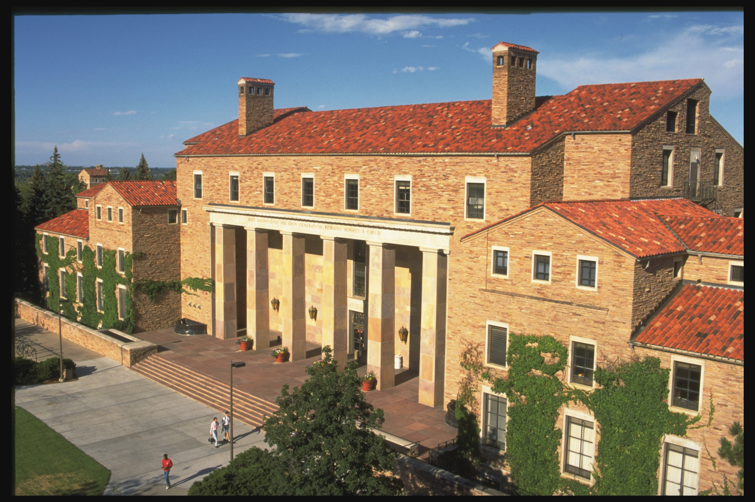
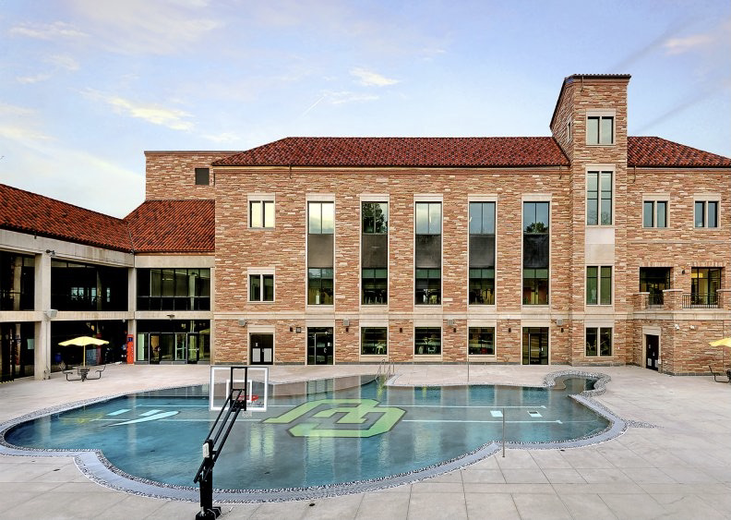

Slide 3
Clinical Psychology PhD Program
Fall 2022 Application Deadline is December 1, 2021 at 10 pm Mountain Time
The General Application Form requires a $60 fee
GRE General Test results are optional, there are no minimum score requirements
Accredited by the Commission of Accreditation of the American Psychological Association since 1949

Slide 4
Tuition and Fees
In state tuition is $2,028 for 1-3 credit hours, $676 per credit hour after that
Out of state tuition is $5,370 for 1-3 credit hours, $1,790 per credit hour after that
Mandatory fees are approximately $887.35 per semester for full time students

Slide 5
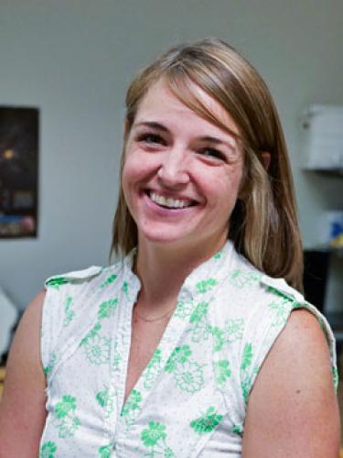
Faculty

Slide 6
“The purpose of the program is to prepare students for academic and applied research careers. It is not designed to train private practitioners.”

Slide 7
Sources
https://www.colorado.edu/clinicalpsychology/about-us
This is the main link for the clinical psychology program. All information was found on the website. The photos of the school were found using Google Images

