Slide 1
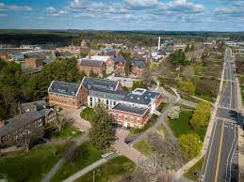
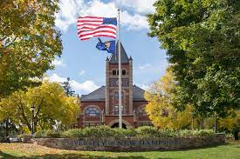
Masters Therapeutic Recreation Administration
Durham,NH
By: Darcy Jolicoeur

Slide 2
Admission Process
March 18, Fall Admission, November 15, Spring Admission
UNH Graduate School Account/Application Fee
GRE’s no long required for admission
Personal Essay Statement is required
Three letters of recommendation
Resume
Transcript

Slide 3
Credits and Programing
Therapeutic Recreation Administration is 30 credits
Currently the TR is an in person program, however two courses are fully online at this time
TR option at the undergrad level is accredited by the Commission on the Accreditation of Recreational Therapy (CARTE)
TR graduate program is not yet accredited. The future master accreditation is being considered through the Council on Accreditation of Parks, Recreation, Tourism, and Related Professions (COAPRT)

Slide 4
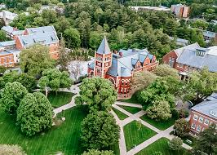
Tuition and Fees
Account/Application fee $65
Resident cost $7,087 per semester
Out of state $13,905 per semester
$20 part-time fee for under nine credit
Technology fee $53.50

Slide 5
Therapeutic Recreation Faculty Member
Dr. Patti Craig
Associates Professor/Graduate Program Coordinator
Recreation and Policy Department
Research Methodology
Mixed Methods
Qualitative(case study, phenomenology)
Quantitative(quasi-experimental)
Participant Action Research

Slide 6
Employment
Employment of Recreational Therapists is projected to grow 8% from 2019 to 2029 which is faster than the average of all occupations
As baby-boom generation ages the need of recreational therapists increases to treat age-related injuries and illness such as stroke
Recreational Therapists will help chronic diseases such as diabetes and obesity
CNN money magazine states recreational therapy among the top 10 best jobs for saving the world

Slide 7
Resources
https://chhs.unh.edu/recreation-management-policy/program/ms/recreation-management-policy-therapeutic-recreation-administration
https://gradschool.unh.edu/admissions/financial
https://www.monster.com/career-advice/article/recreational-therapists-help-patients-play-to-win-0615
https://chhs.unh.edu/recreation-management-policy/program/ms/recreation-management-policy-therapeutic-recreation-administration#collapse-wapirequirements
https://gradschool.unh.edu/academics/accelerated-masters-program

