Slide 1

University of Tennessee Knoxville
Jael Jean

Slide 2


About the University
Public University
Graduation rate 68%

Slide 3
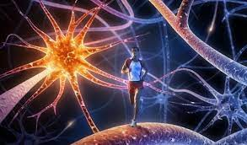
Sports Psychology
Masters or Doctoral degree in clinical, counseling, or sports psychology.
Kinesiology Master’s Program

Slide 4

Questions
1. what is the timeline for submitting an application?
2 Is there a fee for submitting an application?
3. What is the minimal score for the GRE or MAT?
4.How many credits are required?
5. Is there a distance component or are all classes on campus?
6. Is the program accredited ? Is it CACREP, CORE, APA or CSWE?
7. Name one faculty member in the department and what their research focus is?
8. Is an easy required? If so do they give you a topic?
9. Where is the university located?
10. How much is tuition?
11. What is the job market for this job with this degree?

