Slide 1










UNIVERSITY
OF CINCINNATI
Social Work MSW
Kahli Harvey
COE 313

Slide 2
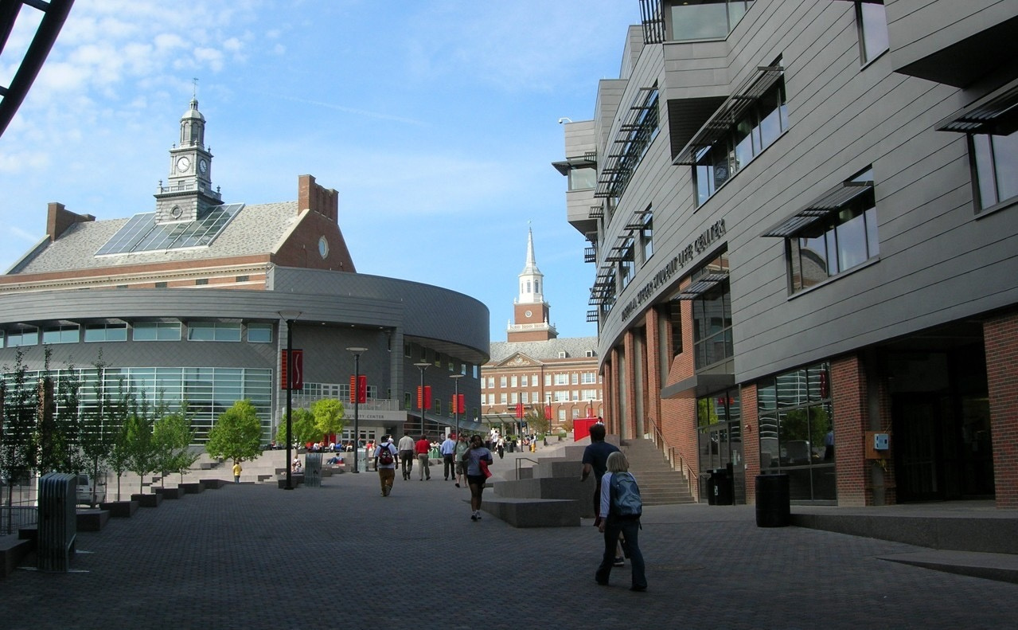
University of Cincinnati
Cincinnati, Ohio

Slide 3

ADMISSIONS
REQUIREMENTS
DEADLINES
CREDITS
  A résumé
  A personal statement
  Three letters of reference, preferably one academic and two professional.
  ​Copies of unofficial transcripts from all undergraduate institutions attended
  A $65 application fee.
  GRE is not required
  Full Time: 44-60 credits
  Accelerated: 34-60
Both require a field placement
  Fall: February 15
  Early Decision: November 30

Slide 4








All classes are on campus
CSWE Accredited
ADDITIONAL INFORMATION
No essay topic specified
Tuition is $13,322/semester
Health Center

Slide 5


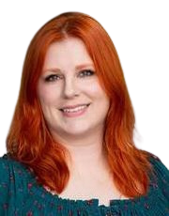


Research Interests:
  Social justice and youth development in improving outcomes for youth with historically excluded identities
  “The overarching goal of Dr. Bloomer’s research is to contribute to the well-being of youth facing discrimination and oppression by using methods and analytic techniques that amplify their voices and build critical consciousness.”
REBECKA M BLOOMER , PH.D., MSSW

Slide 6


JOB MARKET
  Child and family social workers
  School social workers
  Healthcare social workers
  Mental health and substance abuse social workers
Expected 7% job growth between 2022-32
From the Bureau of Labor Statistics:
Average income:
$61,420

