Slide 1
Community Resource Project
Dorothea Dix Psychiatric Center (DDPC)
Kaley Kyle

Slide 2
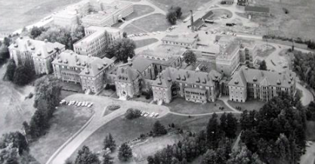
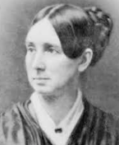
History
Established in 1895, located in Bangor
Named after Dorothea Dix in 2005, who is most known for her advocacy for better treatment of the mentally ill
Previously known as the Eastern Maine Insane Asylum, and also the Bangor Mental Health Institute
1 of 2 psychiatric hospitals in Maine

Slide 3
Care and Services
51 bed psychiatric hospital
Inpatient and outpatient care
Services primarily given to eastern Maine’s severest mentally ill patients
Voluntary and involuntary patients
Following admission, comprehensive discharge planning starts
Individual and group counseling led by staff vary by treatment plan

Slide 4
Care and Services (cont)
Philosophy concerns the biopsychosocial needs of patients, core belief in recovery and habilitation models
Treatment is modeled after a balanced life of leisure, and productive and self-care activities.
The importance of family, community, meaningful life roles is understood and used to promote and help maintain mental health

Slide 5
Types of Jobs
Psychiatric and medical physicians
Social workers
Nursing staff
Interviewed for this project
Recreation therapists
Psychologists
Clinical counselors
Occupational therapists
Clinical dieticians
Peer support specialists
Chaplain

Slide 6
The Interview
Interviewed a Nurse who works there
Working as an RN III for 5.5 out of the 10 years she has worked at DDPC
RN III signifies that one has psychiatric experience and have been trained to fill in as a Nurse Supervisor
Some of the things I learned:
Nurses have a lot of autonomy
They do not read EKGs at DDPC
The importance of being able to sit and listen
It is extremely difficult to treat a majority of involuntary patients
Since working there, she has not noticed any changes in treatment at DDPC to mirror new findings about the brain, psychiatry, psychology, mental health, etc
There is a lot more structure to the work day than I had previously thought

