Slide 2
The Johns Hopkins University School of Medicine is a private research university in Baltimore, Maryland.
For successful admission to Johns Hopkins, students must,
complete the GRE with a minimum score of 313
have a MCAT score of 526 or higher
Along with this, students must have completed at least 120 credits, completing all distribution requirements and writing-intensive credits, as well as earning grades of C- or better in all major/minor courses.

Slide 3
Application Process…
Submission of AMCAS Application - October 15th, 2022
Letters of Recommendation must be received by November 1st, 2022
Virtual Interview Dates - From September 21st to January 12th
Decision Letters Mailed by Mid-February 2023
Prerequisites must be completed by August 1st, 2023
Application fee - $85
There is an optional essay; applicants may use this opportunity to address information not already noted in the application that will enable the Committee to know more about them.

Slide 4
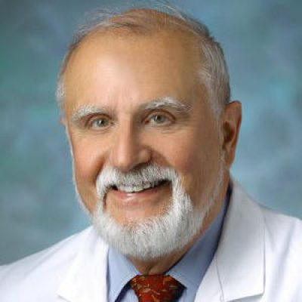
Faculty Member - James Harris, MD
Dr. Harris is a professor in the Division of Child and Adolescent Psychiatry and the director of the Developmental Neuropsychiatry Clinic at Johns Hopkins University
Harris’ research focuses on behavioral phenotypes in neurogenetic disorders and psychopharmacology in neurodevelopmental disorders.
Author of the textbook “Development Neuropsychiatry”

Slide 5
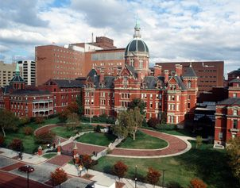
Johns Hopkins offers dozens of online courses and programs for those who are unable to commute or reside on campus; some for credit, and others for free, through their partnership with Coursera.
Full-Time Tuition - $58,000
Accredited by the Middle States Commission on Higher Education (MSCHE)
Graduates have gone on to pursue careers such as, internal medicine, pediatrics, pathology, and neurology

