Slide 1

Community Resource Project
School Counselor
By: Brianna Moon

Slide 2

Agencies involved
1.) Department of Health and Human Services- 109 Capitol St, Augusta, ME 04330 (207-287-3707)
2.) Maine Department of Education- 23 State House Station, Augusta, ME 04333-0023 (207-624-6600)
3.) Spurwink- 901 Washington Ave, Suite 100, Portland, ME 04103 (888-889-3903)
4.) Community Health and Counseling- 42 Cedar St, Bangor, ME (1-800-924-0366)
School counselors are typically employed through schools and the government, but these sources are some of those that involve social work of the same sort.

Slide 3

Interviewing Marie
-school counselor in Lee, ME for elementary and junior high.
-Also taught at region 3.
-When she started, the program was for a masters, but she believes has now changed to a doctorate program.
-Many responsibilities along with that of counseling.
-Busy but rewarding.

Slide 4

The typical day as described
-working part time in lee, she split her time between the two schools doing classroom guidance, group counseling, and one-on-one counseling.
-civil rights, sex-ed, puberty lessons, and lunch and recess duties.

Slide 5
Her starting salary AT THE TIME
SHE SAID IT WAS VERY LOW, DUE TO THE LOCATION.
24,000/YEAR FOR FULL TIME.
SOUTHERN MAINE PAID MORE.
SHE SAID SHE BELIEVES NOW THAT PAY WILL CONTINUE TO RISE WITH THE YEARS.

Slide 6
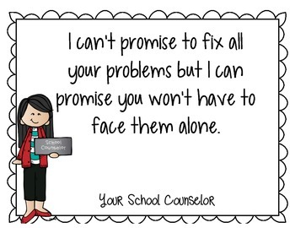
WHY SCHOOL COUNSELING?
-REWARDING.
-FLEXIBLE.
-STARTING A FAMILY.
-SEEING CHANGE.
-SUPPORTIVE ENVIRONMENT.

Slide 7
ADVICE FROM MARIE
-”Take care of yourself. Counseling is a high burnout job. There is a lot you see that is very difficult, so taking time for yourself in whatever way is a must! If you like working with children, it’s perfect.”

Slide 8

What I learned
Pros:
-Job security
-Flexibility
-Benefits
-Make change
Cons:
-Educational road
-Limited time
-Salary
-Stress level

