Slide 1
Community Resource Project
Darby Dupuis

Slide 2
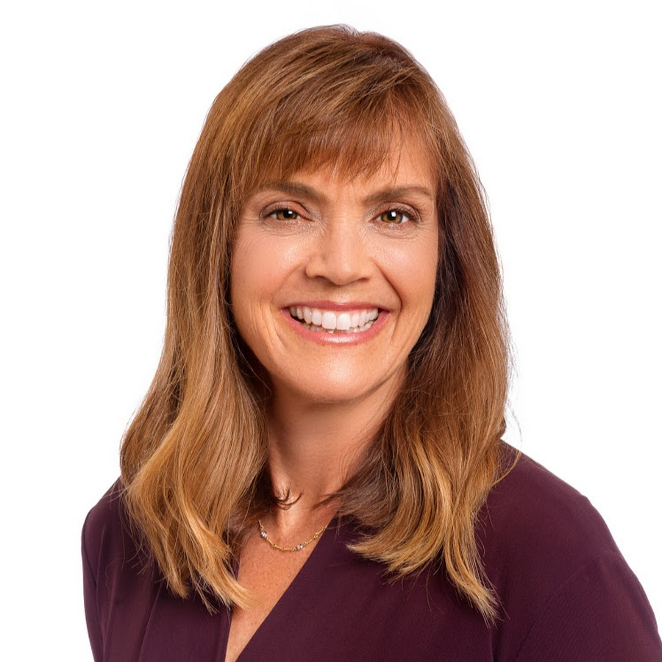
Who did I interview?

Slide 3
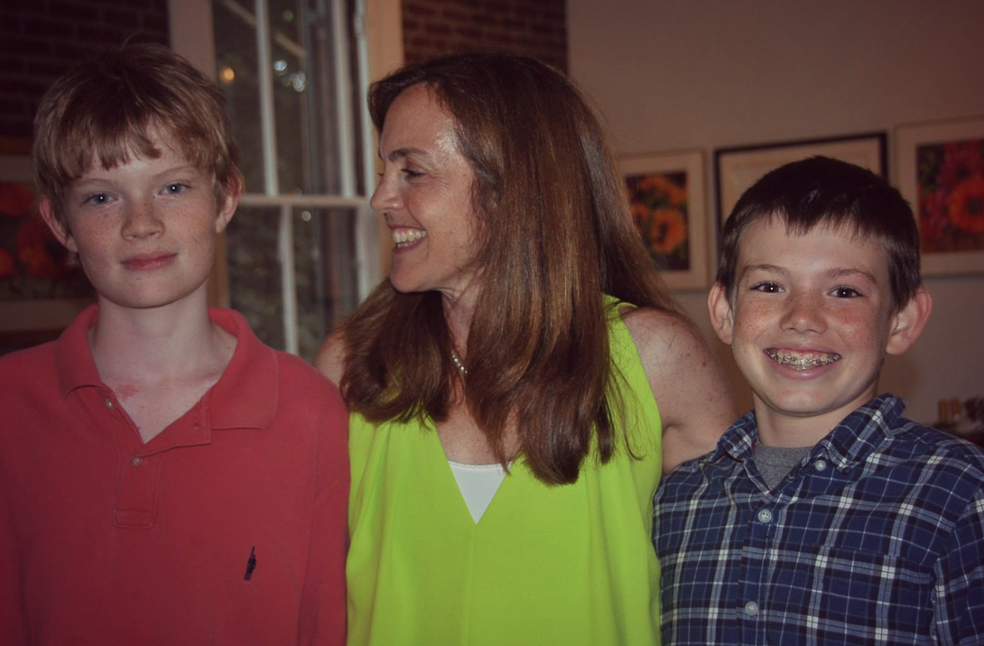
LYNN LYONS BACKGROUND & EDUCATION

Slide 4
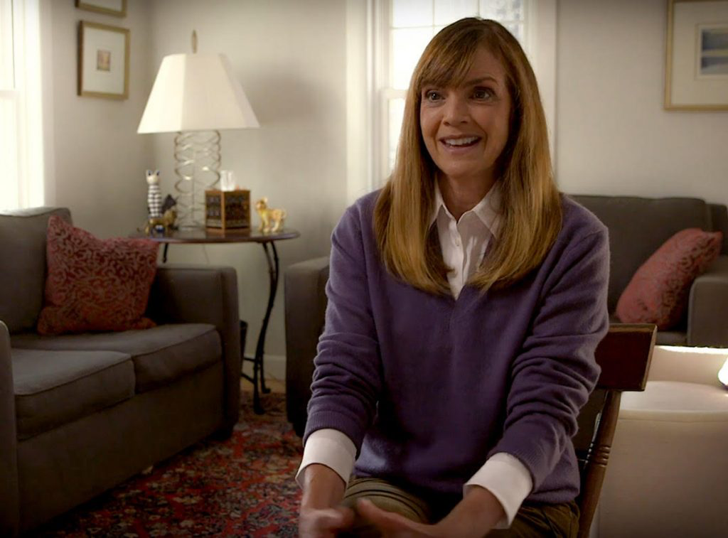
Job Title & Services Provided

Slide 5
INSPIRATION TO PURSUE CAREER

Slide 6
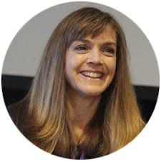
HARDEST part of the job

Slide 7
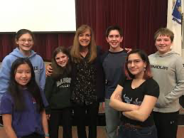
Favorite part of the job

Slide 8
Effects of Covid

Slide 9
Advice for those looking to pursue a similar career

Slide 10
Additional Comments

Slide 11
Contact Info & LINKS TO LEARN MORE ABOUT LYNN
https://www.lynnlyons.com/
https://www.facebook.com/lynnlyonsanxiety/
Address: 103 Auburn St, Concord, NH 03301
Phone: (603) 225-4147

