Slide 1
Recovery Center of America
By Kaycie Groom
MHR 210

Slide 2
Recovery Centers of America at Danvers
It is located in Danvers, Massachusetts.
This is for individuals who are detoxing from alcohol, opioids, and benzo’s.
They provide patients with 24/7 treatment, and let them know they matter.
The inside is designed like a hotel so they feel comfortable while they are their, and know they matter to the workers.

Slide 3
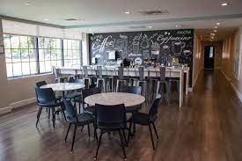

Slide 4
Offered Services
Alcohol detox
Drug detox
Inpatient treatment
Outpatient treatment
Medication assisted treatment
Substance abuse treatments

Slide 5
About the RCA Nurse
The shifts are broken down from 7am-3pm, or 3pm-11pm
Hourly salary is about 35-45 $ per hour
They check the patients vitals, give them dosages of medicine if needed,and do lab checks for infections.
The nurses get the patients vitals every two hours, and medication dosage every four hours.

Slide 6
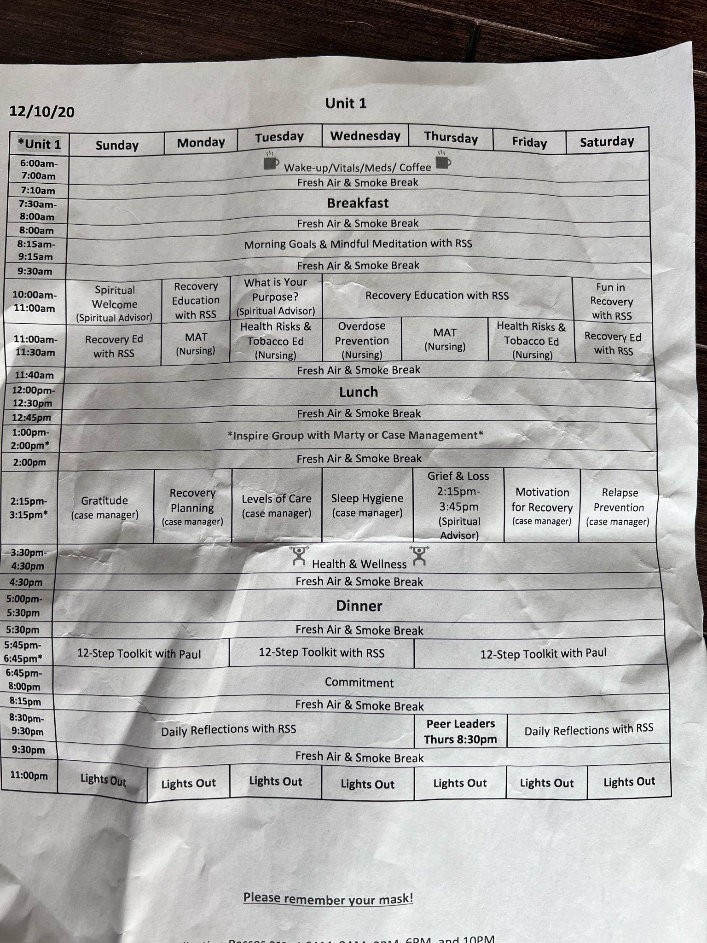
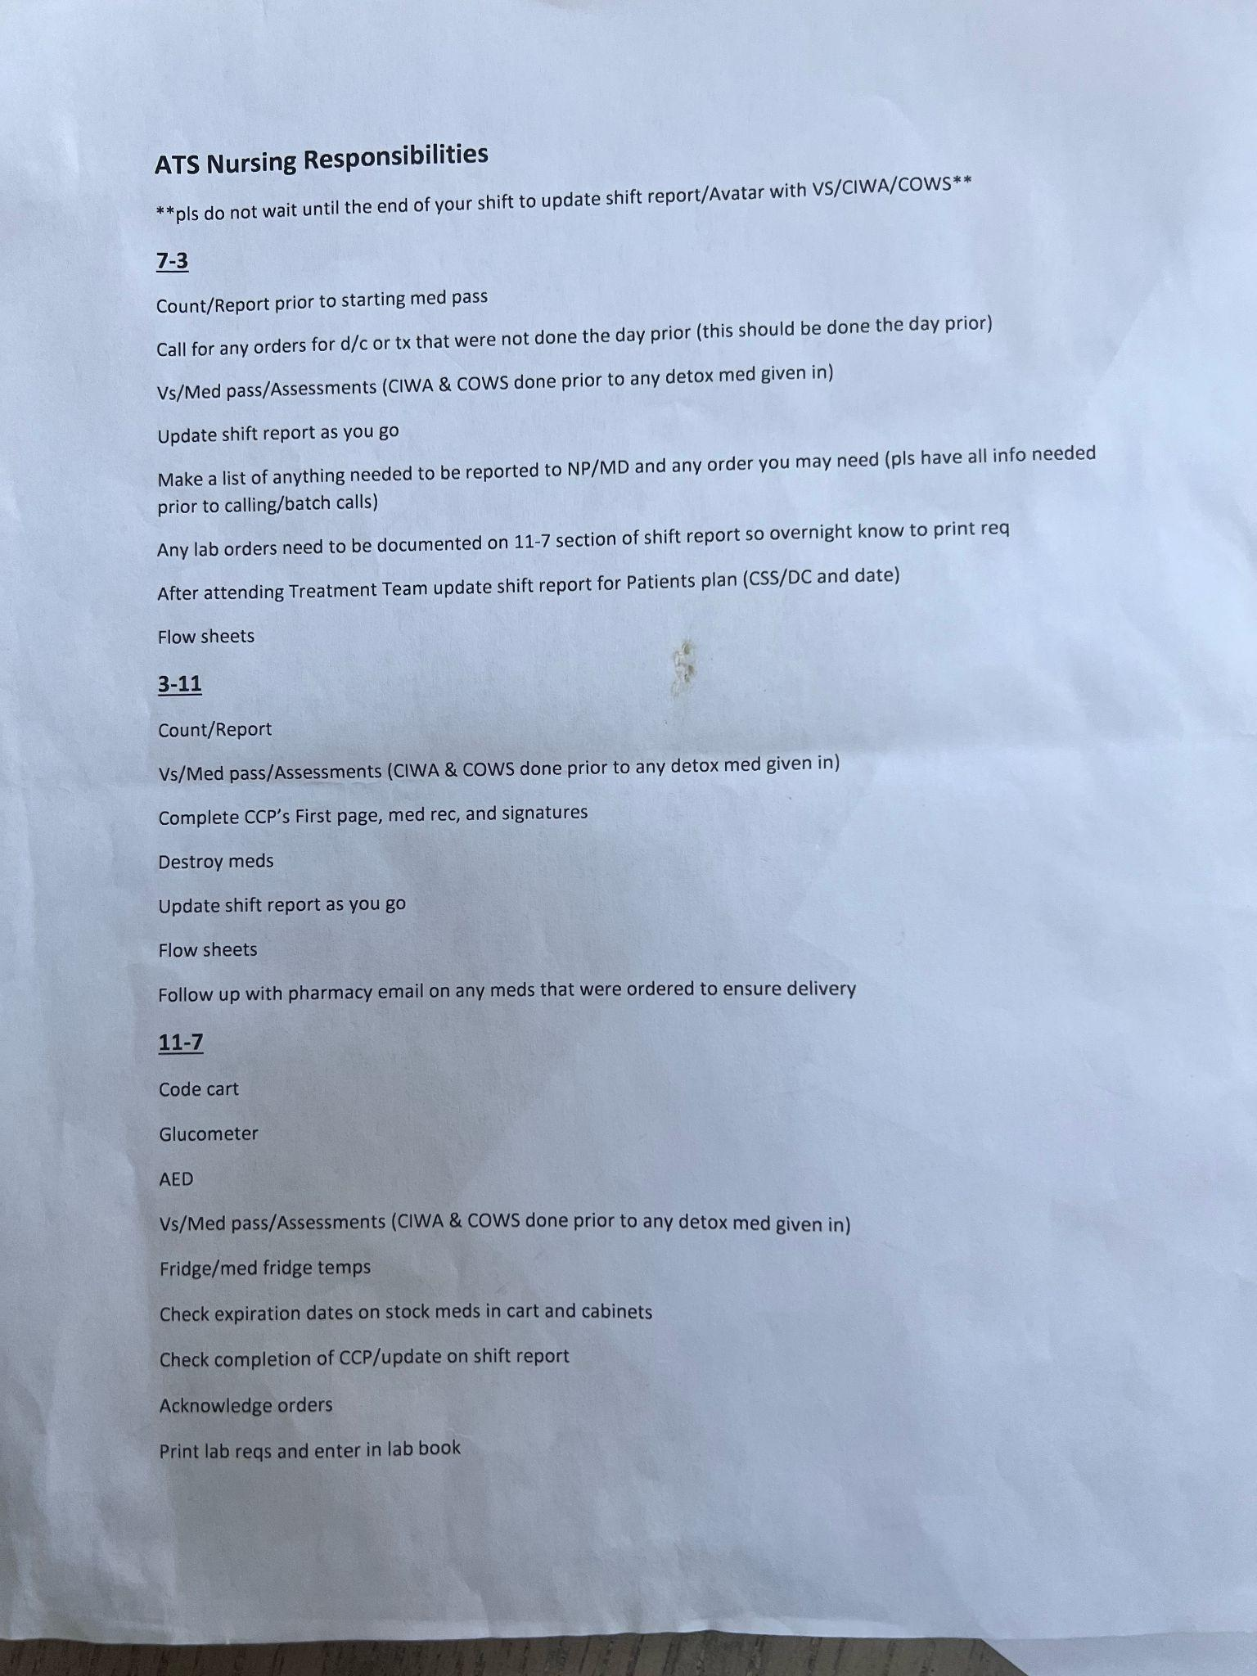

Slide 7
After Inpatient Care
After patients have completed inpatient care they are moved upstairs where they are helped with setting up further care.
The staff works with patients to see what they need to do after their care to keep them sober which can be counseling, case management, AA meeting, ect.
Since most patients are homeless they work with them to help them find a place to go after they are done detoxing.

