Slide 1
MRC Vocational
Rehabilitation
Samantha Guinard

Slide 2


MRC Vocational Rehabilitation - What is it?
The Massachusetts Rehabilitation Commission is a part of the Network of Care in Massachusetts.
Their mission is to help individuals with disabilities live and work independently.
Besides Vocational Rehabilitation, the MRC is also responsible for Community Living and eligibility for Social Security Disability Insurance (SSDI) and Supplemental Security Income (SSI).

Slide 3
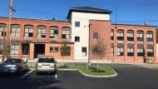
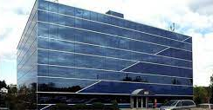
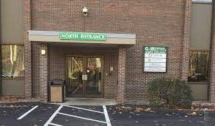
MRC Office Locations Near Me
MRC Fitchburg Office
49 Nursery Lane, Fitchburg, MA 01420-5785
Phone: (978) 345-1713
MRC Framingham Office
463 Worcester Road, Suite 305, Framingham, MA 01701-5356
Phone: (508) 370-4700
MRC Greenfield Office
101 Munson Street, Suite 205, Greenfield, MA 01301
Phone: (413) 774-2326

Slide 4


Informational Sessions - Process
In order to get any information on the services that are provided by the MRC in Fitchburg, MA (the closest location), I had to call the office.
Originally, I was calling to see if i could get an interview with somebody. I was met with a voice directory that detailed the different options available within the office directory.
I had to leave a voicemail so that someone could reach out to me with the details for the monthly informational session. I was not able to conduct an interview, but I did get the details for the informational session.

Slide 5


Informational Sessions - Services
To receive vocational rehabilitation services, you must meet the following criteria:
  Have a physical, mental, emotional or learning disability which severely limits your ability to get and keep a job
  Have motivation to work and keep a job
  Be a U. S. citizen or have authorization to work
  A sustained amount of sobriety and ongoing supports before referring yourself for service.
An initial interview is conducted, and from that you meet with a counselor to work on your individual process.

Slide 6


Informational Sessions - Services (cont.)
Services Provided will reflect the individuals aspects, needs, and goals.
After determining eligibility, an individual plan of employment will be created.
Following the creation of the individual plan, the process from there will be to work with your counselor for whatever training and education you may need to complete in order to work towards your goals.

Slide 7


Informational Sessions - Services (cont.)
Job Placement Services are provided if assistance is needed:
  Resume writing
  Interviewing skills
  Developing job leads
  Employer advocacy
  On-The-Job Evaluation or Training
Post employment services are provided by the MRC for 90 days after securing a job
  These services are support, advocacy, and follow up services.

Slide 8
My Experience
Initially, I was a bit nervous when getting through the phone directory when trying to contact the MRC in Fitchburg. There were many different pathways and I wasn’t quite sure which to take so that I could get ahold of a real person.
The information that i obtained was very helpful considering the field i wish to get into. A lot of the services that they provide (not just the vocational rehabilitation) can come in handy for a multitude of different fields that I am interested in.

Slide 9
References
https://www.mass.gov/locations/mrc-fitchburg
https://www.mass.gov/vocational-rehabilitation
https://www.mass.gov/lists/mrc-consumer-handbook-of-services

