Slide 1
Independent Living Support Services and Homecare
FirstLight Home Care
By Sierra Pomerleau

Slide 2
What are Independent Living Services-
Independent Living Services provides skills and programs based on the concept that by learning independent living skills, persons with developmental disabilities may be able to live freely in the house of their choice. This presupposes that the individual will be able to gain the skills needed to run a self-sufficient home and that training will become less intensive over time

Slide 3
What is home care-
Any professional support services that allow a person to live comfortably in their own home are classified as home care. In-home care services can aid someone who is aging and requires support to live independently, is dealing with chronic health problems, is recuperating from a medical setback, or has special requirements or a handicap. Depending on a person's needs, professional caregivers such as nurses, assistants, and therapists offer short-term or long-term care in the home.

Slide 4
Why are these services important?
Being self-sufficient might be difficult due to limitations and challenges posed by a disability. Indepeservices help assist those with essential requirements that will enable them to live a more meaningful and self-sufficient existence. People with disabilities should have the same opportunities as everyone else to enjoy a high quality of life
Patients who get home care have the benefit of developing trusted connections with dependable caregivers and receiving care in the privacy of their own homes.

Slide 5
FirstLight Home Care
“At FirstLight Home Care, we understand the benefits of allowing older adults the freedom to age gracefully in the place they call home. Our senior care services provide daily assistance and essential in-home support that the elderly need to live a life of dignity, with as much independence as possible.”

Slide 6
Firstlight home care doesn’t just focus on elderly care, they also specialize in companion care, personal care, dementia care and related disabilities, brain health services, and more
Companion carers provide social assistance to elders... This social support can help to decrease boredom, unhappiness, loneliness, and feelings of isolation. Companion care is intended to give meaningful participation in the client's favorite activities and life
Firstlight designed dementia care plans to assist persons with Dementia or Alzheimer's to manage with the worry, despair, disorientation, and loneliness that typically accompany the condition. Their one-of-a-kind dementia care services at home benefit not only the dementia patient, but also the entire family. "You've only met one person with dementia if you've met one person with dementia." That is, because each person speaks, acts, remembers, and behaves differently, first light concentrates attention on the person rather than the sickness.

Slide 7
What are the advantages of care at home versus care in a senior living community?
“In a word: freedom. According to AARP, more than 90 percent of people over the age of 65 want to stay in their homes as long as possible. Why? Because they enjoy their independence. In-home care can be an alternative to a nursing home or other senior living community. Our elderly care services allow seniors to stay active longer, maintain their own schedules and remain in a familiar environment”

Slide 8
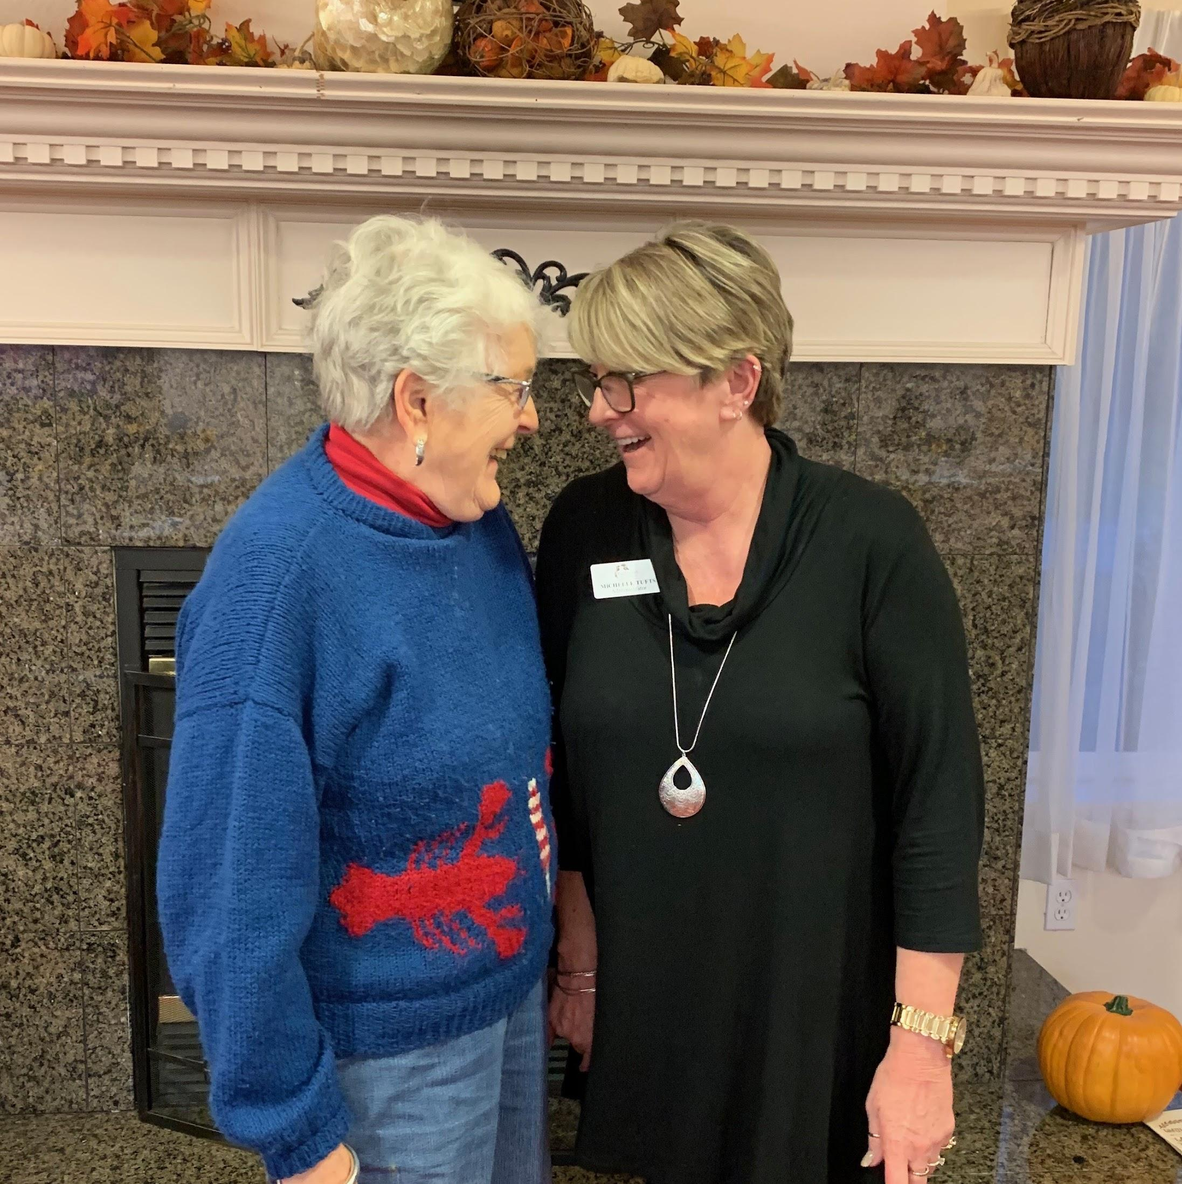
Interview
Michelle Tufts, a member of FirstLight Home Care. Works with those with both physical disabilities and dementia and over 20 years in the assisted living community realm.

Slide 9
What do you find is the most important and meaningful part of you job?
As an individual: Compassion, you have to be compassionate because the need emotional support and ultimately a person that truly cares. Dependable-Because you are there to keep them safe, secure, and help support them through their current chapter of their life. In the end it is the people, the ones to be the caregiver.

Slide 10
Why do you think at home care and other related services are important?
Home care is important because keeps them in their own home, in their comfort and a place where they are familiar with. Comfortable and familararily are something we all hold dear and don’t always realize until that thought becomes threatened. We are to be there not just as a job but someone in their support system they look up to and can always be there.

Slide 11
What is the biggest challenge when working with those with physical and mental disabilities?
In the literal way, redirection when they get fixated on something, and knowing how to redirect the individual to their personal preference. You really have to know the person and have 100% your focus and patience with them. It’s not more or so of an individual challenge but not everyone has patience and people often take care as a general term with one set of rules.

Slide 12
Do you think home care and other independent services are not getting enough attention?
Need more people, caregiving takes a certain type of person. Patience. Its hard in our current world and society and there’s no individual to blame, so many things going on now a days. However those in need and of assistance shouldn’t be last thought whether that’s from an individual, company, or society. These are still people and shouldn’t be labeled a certain way just because they are in need or want of home care. What we give, anyone should have.

Slide 13
Lastly, do you think some people don’t seek out needed services like home care and if so, why?
I think a lot of people in the case of not receiving home care dont get home care because they don’t have family support to seek it out in the first place when needed. So these are the people who need our support more than anyone because the lack of family or relational support. We need more eyes for these people. As well, a lot of it is financial in general for home care services. Sadly many people can’t afford the care that they deserve. Its a topic society should know shouldn’t be a luxury. A lot of people that do need help don’t want to admit their losing a bit of independence in the sense of their needs. It’s a difficult thing to accept, and should be accepted as a society. We are just people.

Slide 14
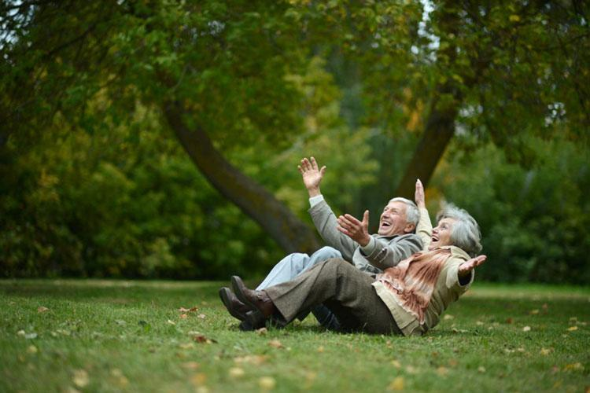
The End

