Slide 1



Clinical Counseling Masters Degree

Slide 2

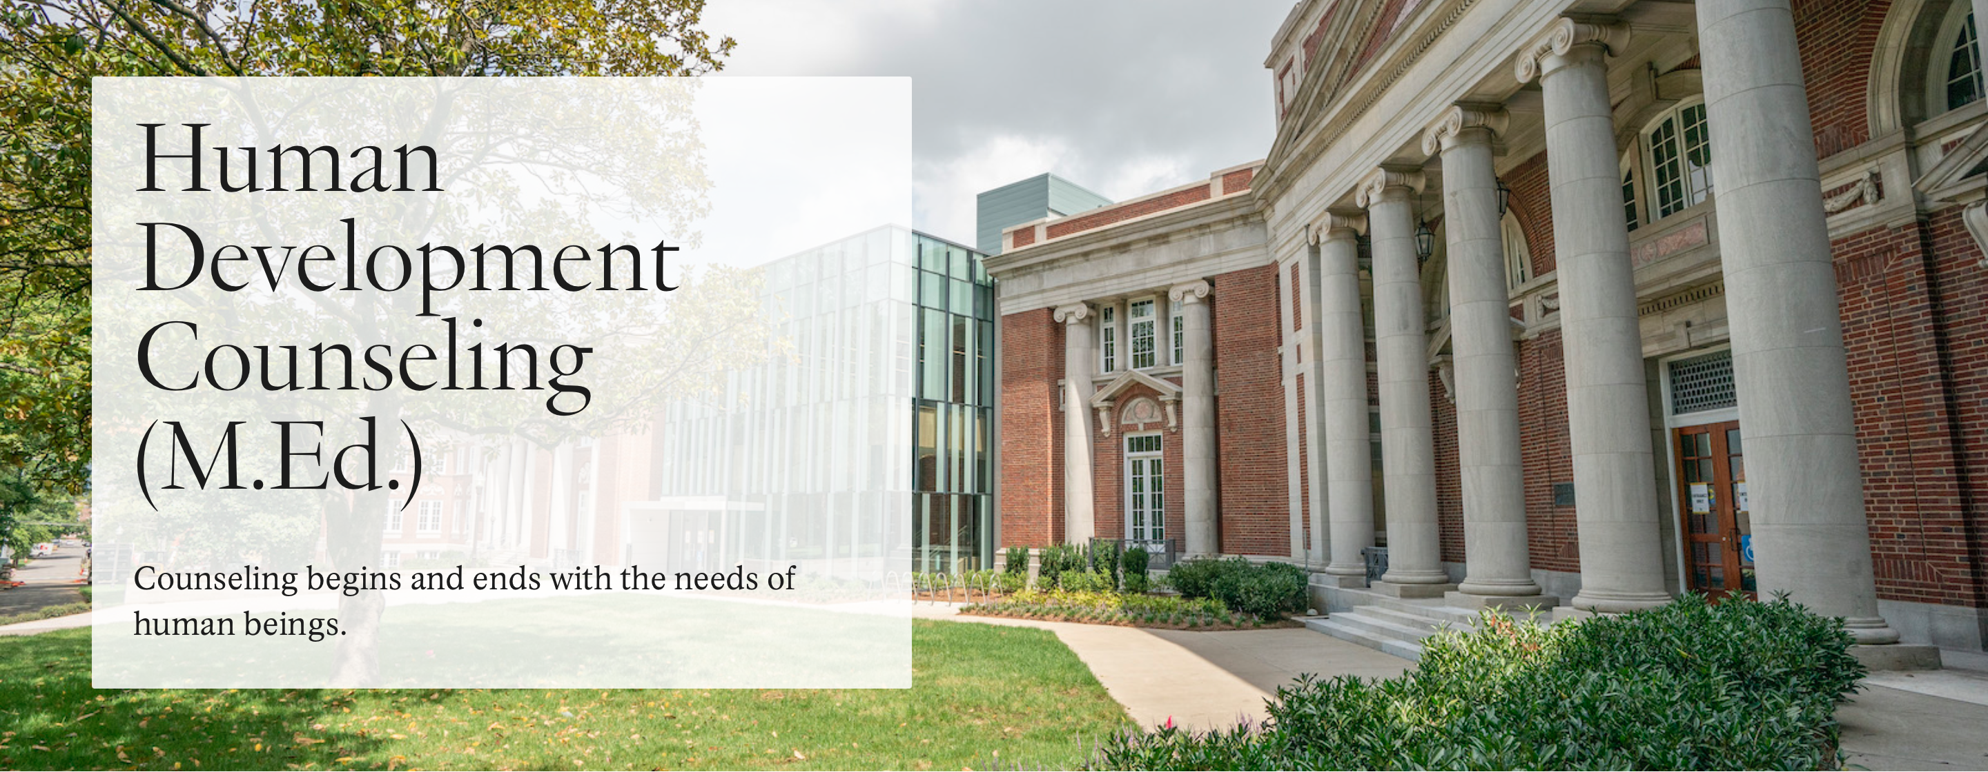

230 Appleton Place
Nashville, TN 37203

Slide 3
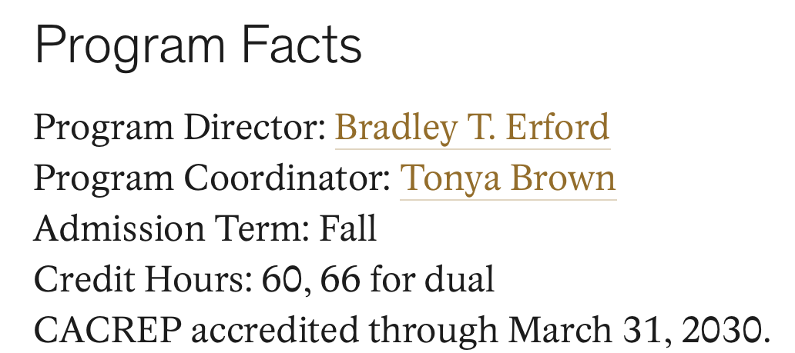
Tuition: about $42,000 per year

Slide 4
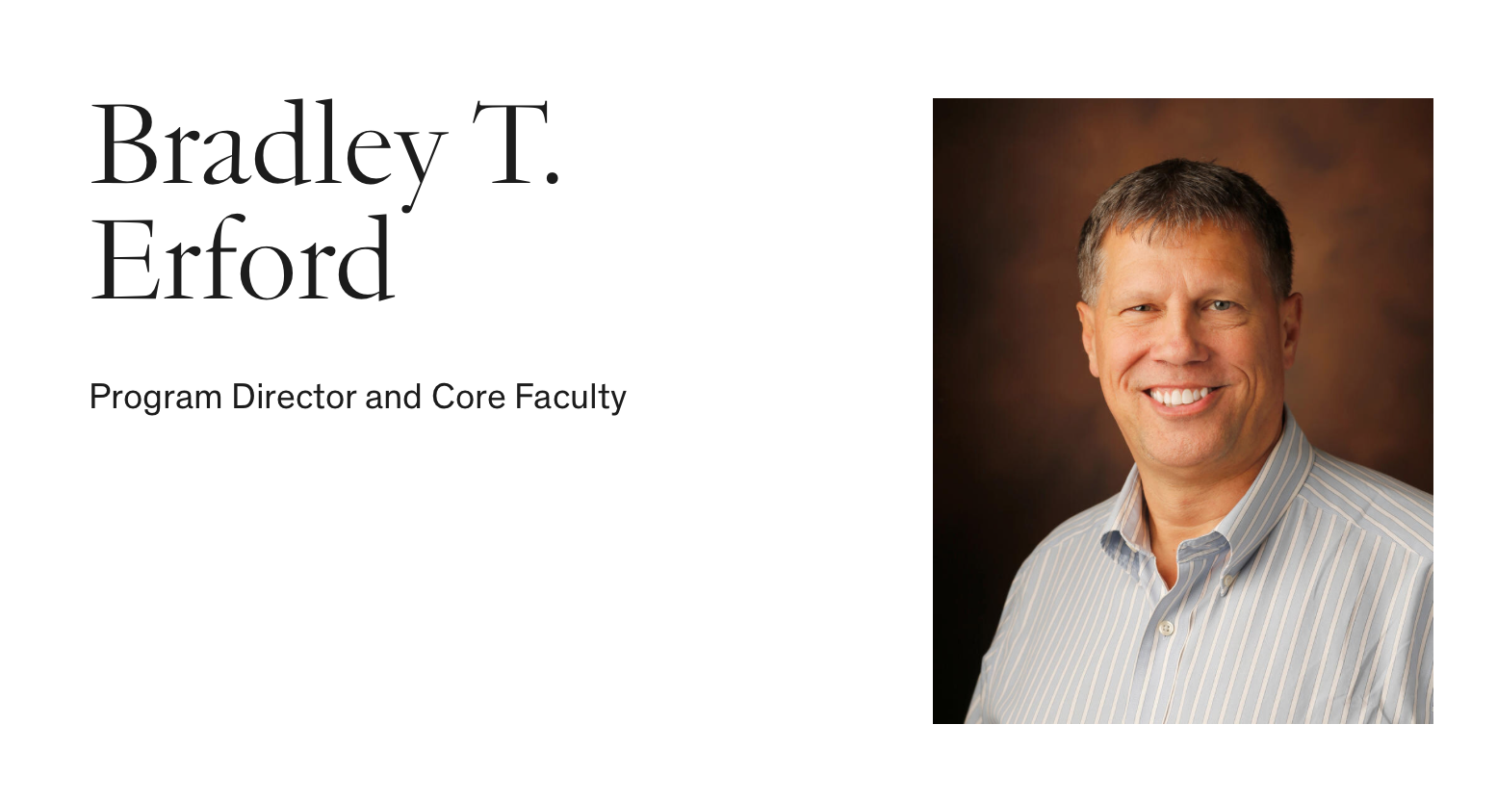
Research Focus: Human Development Counseling

Slide 5
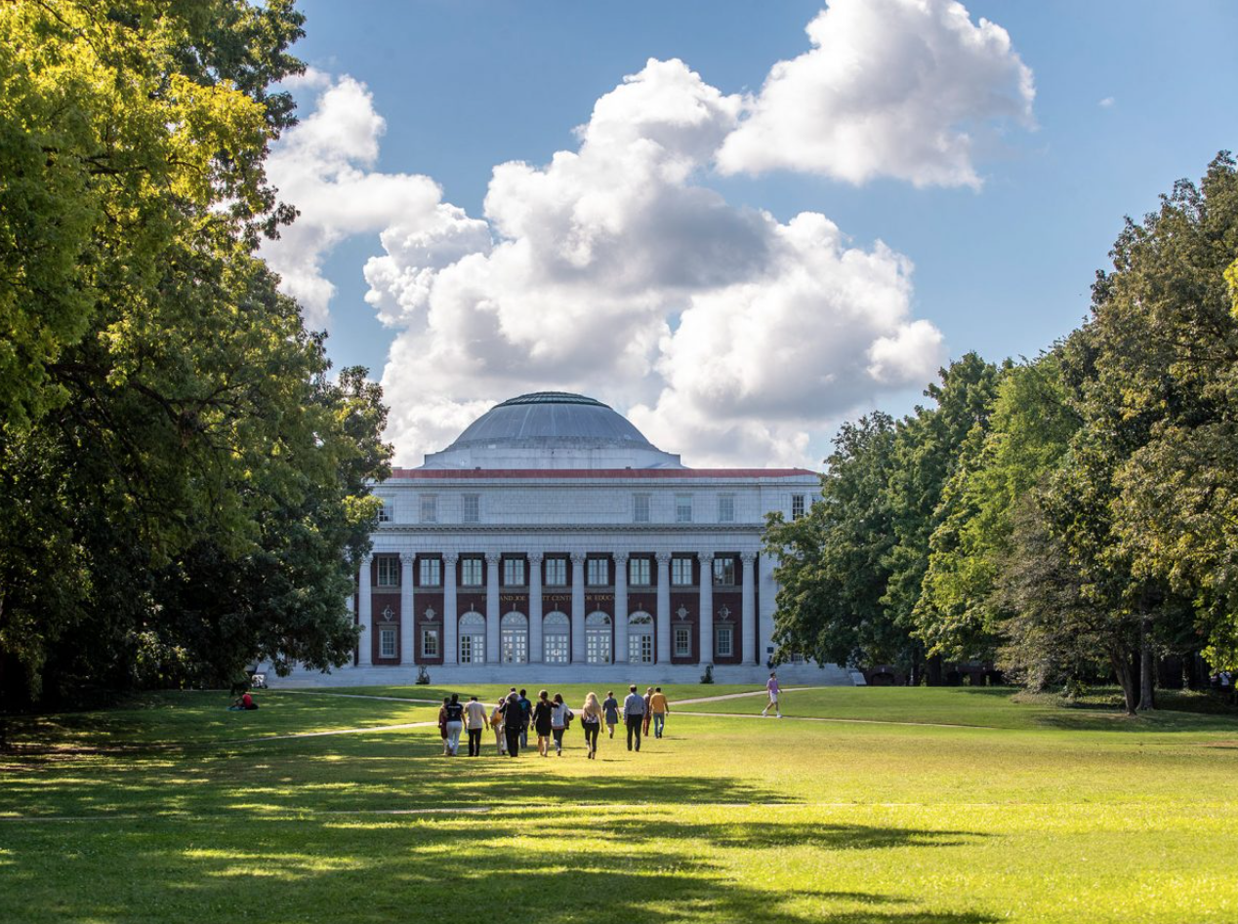
Application Information
Application deadline: January 3rd
Free to apply!
GRE score is optional
Statement of Purpose

Slide 6
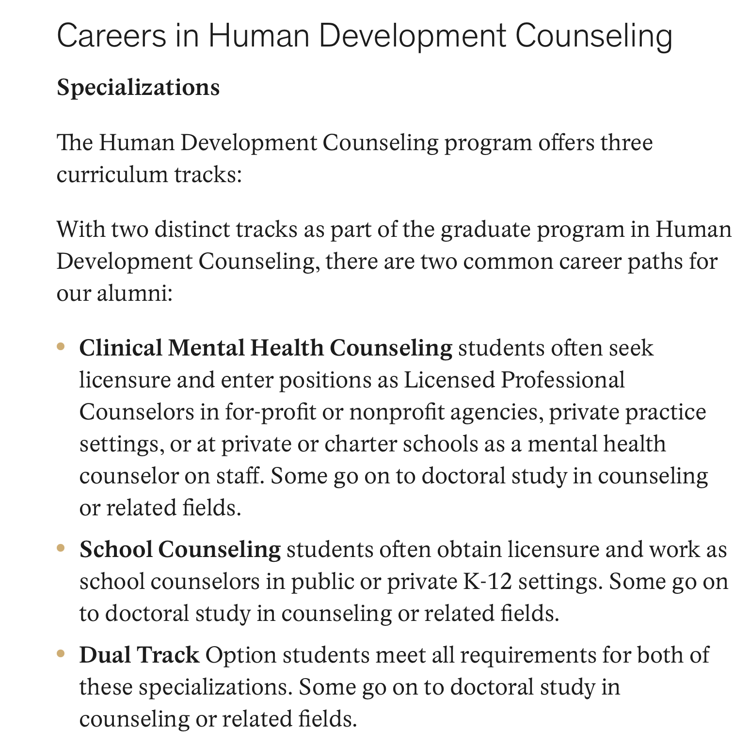
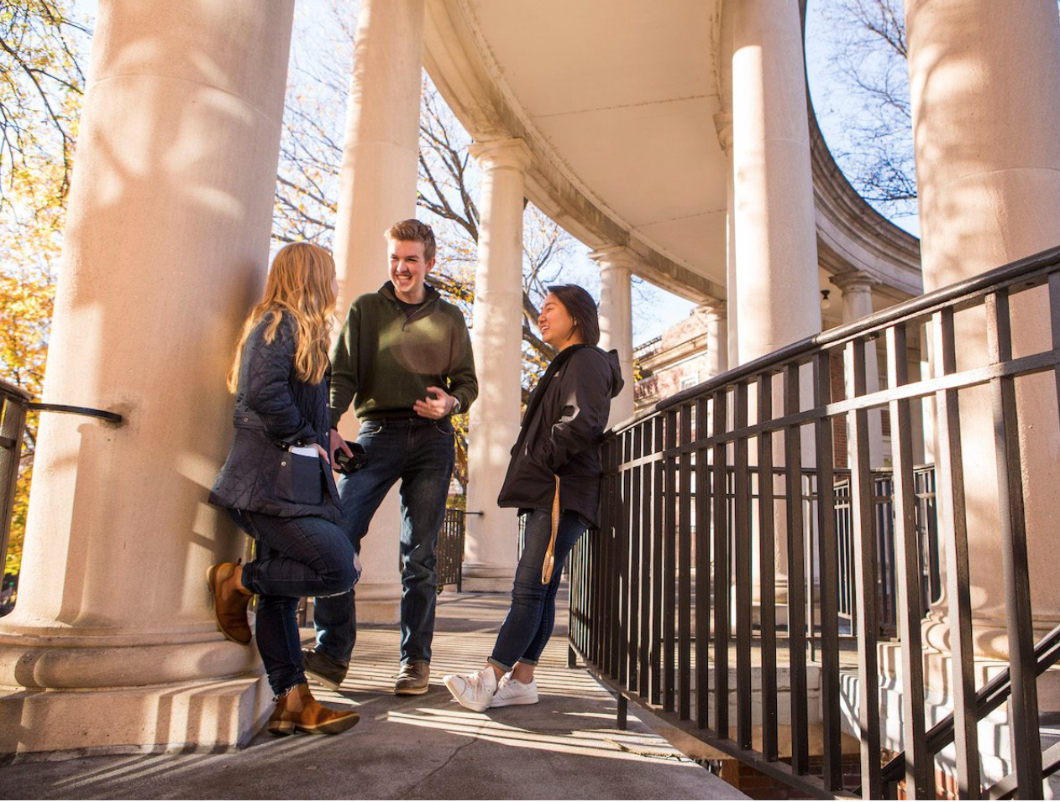

Slide 7
Thank You!!!

