Slide 1
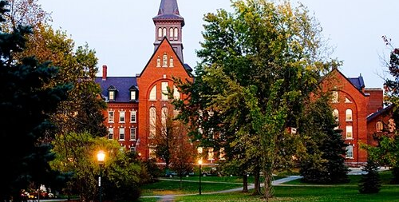
Burlington, VT

Slide 2
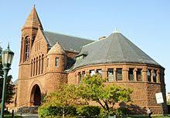
Masters in Science of Counseling Program
University of Vermont
Situated in picturesque Burlington Vermont near Champlain Lake
The University of Vermont is a CACREP/APA accredited university
Offering a variety of Graduate programs including MA, PHD, and AMA degrees.
www.uvm.edu

Slide 3
The Master of Arts in Experimental or Clinical Psychology is aimed at students who want to strengthen their credentials to be competitive for doctoral programs, students who wish to pursue careers that require research skills, or students who wish to gain an understanding of research as it pertains to intervention and prevention.
Accelerated Entry into Master’s Degree Entry Program (AMP) is recommended for undergraduate students who wish to pursue careers in non-research or experimental psychology.
Masters programs are 60 credit programs
Graduate programs are offered on campus only, however housing can be found off campus through the university for those over the age of 20.
Dr. John Green is a chairman of the psychological science department, coordinator of the MA psychology dept as well as a professor.

Slide 4
Admissions
Applications must be submitted by December 1st for the following fall semester
Application fee of $65 is required for MA/PHD programs
GRE/MAT is not required for the Psychology program
A minimum gpa of 3.5 in undergraduate major and overall undergraduate gpa of 3.3 is required for admission
Must have taken a class in abnormal psychology
3 letters of recommendation are required
A choice of an exam, or thesis is required for PHD or programs with focus in research.

Slide 5
Tuition
While Tuition has remained unchanged for the previous 5 years, it is expected to increase for the graduate program in the near future.
Masters in Science of Counseling rates:
Out of state residents: $927 per credit hour =$55,620
Food & housing: $8,202 per semester (4 semsters)=$32,808
Books $50 per credit= $3,000
Personal, transportation & misc. estimated: $3,351 per semester (4 semesters) = $13,404
Grand Total for a Masters degree done in 2 years: $104,832
Limited financial aid is available for Graduate programs enrolled in 5 credits per semester.
Health insurance is required for all full-time students. If a student is uninsured, they must purchase the school's student plan @ $3,814 + copays.

