Slide 1
A Dive into the

Slide 2
Location / Tuition
UCF offers more than 240 degree programs!
The annual cost of attendance for a Florida resident is $24,254 it includes tuition, fees, books, housing, food, transportation, and personal expenses. For non Florida residents tuition is $39,280.
Degrees are offered in person, online and according to the University’s website they offer “ innovative distance learning ”
The University of Central Florida is located in Orlando, in the heart of central Florida. The University is part of the state university system of Florida.

Slide 3
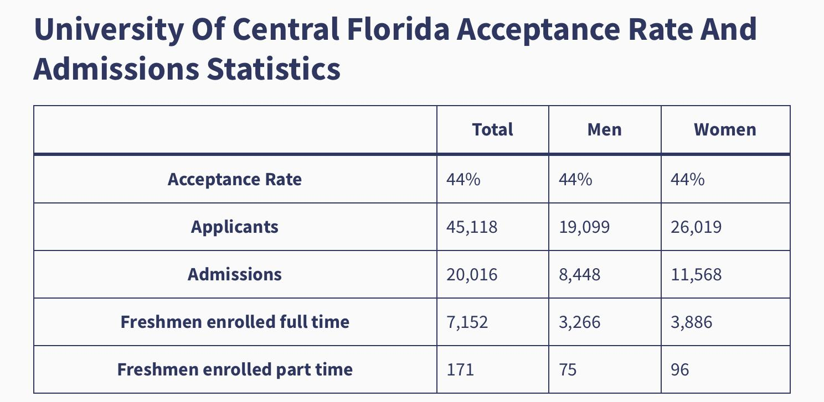
The Timeline for submitting an application
Freshman Application Completion Deadlines
For Fall - May 1
For Spring - November 1
For Summer - March 1
Submission Fee $30
Online Submission Fee $31
Students who are Transferring Deadlines
For Fall - July 1
For Spring - November 1
For Summer - March 1
International student Deadlines
For Fall - March 1
For Spring - September 1
For Summer - January 1

Slide 4
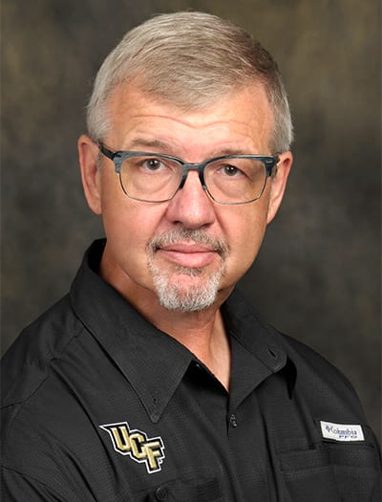
Faculty Member
Clint Bowers
Psy Professor & Research Faculty
Clint Bowers research focuses primarily on the use of technology in the prevention and treatment of psychological disorders. He has been developing games to prevent anxiety disorders in the military and to prevent drinking in college students. He has also developed a game to assist in training relapse prevention skills to inpatient alcoholics. Most recently, He has have been working in the application of various technologies to facilitate prevention programs among military personnel and first responders.
“I am very interested in the use of technology to train psychologists, this work focuses on translating the science of learning into innovative training products for clinicians.”
In 2020 he was appointed as interim chair of the UCF Psychology Department, he currently still is as of 2023.

Slide 5
Program Accreditation
The College of Health Professions and Sciences, the UFC School of Social Work is fully accredited by the Council of Social Work Education.
Social work is one of the fastest growing professions in the United States. A degree in social work offers a meaningful career working with diverse populations, there are many different career paths that you can take with a degree in social work. These include Substance abuse counselor, court advocate, and healthcare social worker.
The median earnings for health sciences graduates is $78,000.

Slide 6
Admission Requirements
For a student to be admitted into the BSW program at the University of Central Florida they must have a minimum of a 2.5 grade point average. In order to gain admission into the BSW Program you must complete an Associate of Arts degree or completion of UCF General Education Program.
Requirements for the Clinical Psychology PhD
Students must have obtained a baccalaureate or higher degree in Psychology, prior to the start of the term for which the student is admitted, from a regionally accredited institution or from a recognized foreign institution. Students without a baccalaureate or higher degree from an accredited institution (or equivalent) are not admitted to graduate degree programs, graduate certificate programs, or graduate non degree status. If the baccalaureate degree does not include a major in Psychology, students must have completed at least 18 credit hours of Psychology courses at the undergraduate level or above.

Slide 7
Cited websites
University Of Central Florida Acceptance Rate - INFOLEARNERS
Psychology | University of Central Florida (ucf.edu)
College of Graduate Studies (ucf.edu)
University of Central Florida | A University for the Future (ucf.edu)
Clint Bowers - Psychology (ucf.edu

