Slide 1
Community Resource Project
Child Case Management

Slide 3
Community Health And Counseling Services
5 main service areas
Home health
Providing care at home.
Hospice
Providing end of life care.
Mental Health
Mental Health services
Primary Care
Help dealing with minor illness and help preventing serious health issues
Foster Care
Family centered foster care
Phone Number: 1-800-924-0366 Email: Contact@chcs-me.org Mailing Address for Corporate Office: PO Box 425, Bangor, Maine 04402
Notes:
Home health - Some services they provide are nursing, physical, occupational and speech therapy, certified nursing assistants (CNAs), social work services, telehealth, wound care.
Hospice -Hospice care can take place wherever your loved one calls home. They have skilled and compassionate staff which provides the physical, emotional and spiritual resources needed to make the most of every moment, with the service and dignity they deserve.
Mental Health services- Split into two areas Child and adult (18+)
Foster care; you can find resources for becoming a foster parent or resources for current forster parents.

Slide 5
Wings For Children And Families
3 Main Services Offered
Child Behavioral Health Home
Meeting the client’s child and family needs
Child Targeted Case Management
Works with child and family to devise a plan to help the child
Adult Case Management
Help access support and service.
Address: 900 Hammond St. Suite 915 Bangor, ME 04401 Phone: (207) 941-2988
Notes:
Child behavioral health home - Care Coordinators are available to come to your home, attend meetings, make referrals to other programs and services, and monitor progress. They are committed to ensuring satisfaction with the support and services provided to the client’s family.
Child Targeted Case Management - can serve youth from birth through their 21st birthday. We use a family-focused approach called Wraparound that incorporates family strengths and a team-based planning process.
Adult case management- Wings’ Case Managers work and support for the client in achieving the goals they have set for themselves while ensuring their rights are protected. They help clients find jobs, attend day programs, find housing, explore recreational opportunities, access funding, and more.

Slide 7
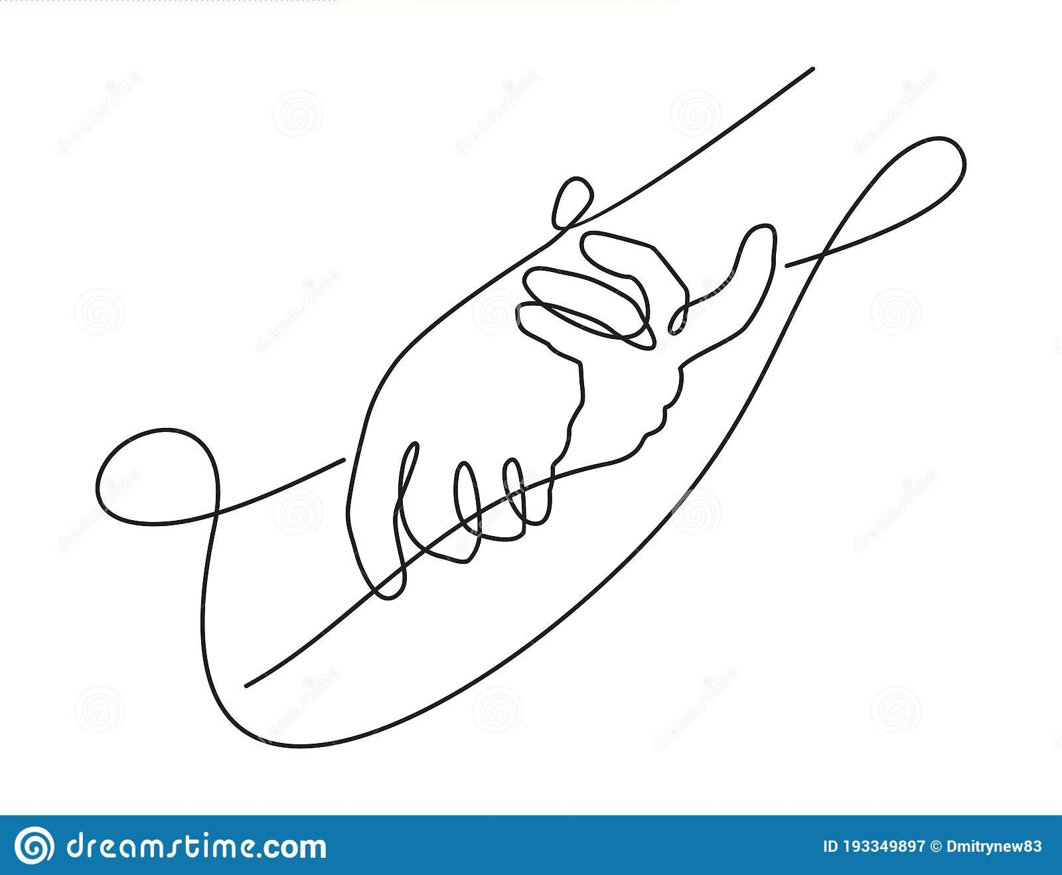
Community Care
5 services
Alternative Response program
Investigate allegations of child abuse and neglect
Community Family support services
Family based therapy program
Children’s case management
Case management for children with mental health needs
Outpatient mental health clinic
Mental health support and therapist
Adult services case management
Helps adults stay independent and not need hospital care
Address: PO Box 936, Bangor, ME 04401 Telephone: 207-945-4240 Email: info@comcareme.org
Notes:
Alternative response program- the reports that are sent to the ARP tend to be those reports that DHHS has determined to be low to moderate risk.
Community Family support services - This is done with support from a Licensed Clinician and a Behavioral Health Professional (BHP) to assist in managing the mental health and behavioral needs of their child, and increasing the caregivers’ confidence and skill set to do so. The service is provided in the family’s home, and occasionally within the community depending on the treatment needs of the child.
Children’s case management- Case management is designed to be a short-term service that coordinates services to address children’s mental health needs, educates parents about resources available to them within their communities, and assists caregivers in navigating the mental health system.
Outpatient mental health clinic-Community Care is fully licensed to provide mental health and substance abuse treatment to families, children, and adults of all ages.
Adult Services Case Management- Some areas of support they offer are housing, financial assistance, Employment/Vocational/Education, mental and physical, trasnportation, building a social network and care integration.

Slide 8
Interview With Community Care Child Case Manager
Andrea Blair Child Case Management From Community Care.
6 Years in Social Work
Why She got in this line of work
What her Job Entails
Hardships she has faced
Inspiring moments
What she would like to known before getting in this line of work.
What she would describe as crucial for future child case manager to know about this line of work.
Notes:
I was lucky enough to interview one of community care’s child case manager. Andrea was really friendly and answered all my questions that I asked. Through this interview I was able to get more insight in the career I want to pursue.
She has always loved children and being around children, She started out as a Pre-School teacher at a private school. She had a child that was exhibiting some unusual behaviors, so she began researching, and then met with parents and they all discussed their observations and concerns, it was her firm belief that this child was on the Autism spectrum. She has worked with the family to research and get him the appropriate services. She also really enjoyed the research and discovering community resources, at that point she knew she wanted to explore social work and case management.
She is responsible to support families with children who have mental health diagnosis, ensuring that the children have the appropriate services in place, or at least referrals made, including mental health services, educational programming and physical health services. Her job also ENTAILS Building a relationship with a family and children to find out what services and supports the family needs, then help them find the supports and getting referrals in place, then continuing to monitor the services once they are in place.
She usually has between 30-35 clients, currently she has 31 clients. How long she works with the client depends. Some last less than a month, some have been with me for years. All depends on needs of family and sometimes the expectations of clients. as well as the expectations of our agency and MaineCare rules
When she is assigned a new client, she reaches out to them to schedule a time to meet and complete intake paperwork. Through completing the paperwork she tries to build a relationship with family, see what they are expecting from services and then also let them know what she can and cannot do for them.
A typical day is a mixture of home visits, office visits, telephone calls to clients/families and service providers, completing necessary paperwork for services, responding to emails, researching community resources and interacting with community providers
Hardships she has faced- Right now for her the hardest part is seeing kids who are in need of particular services and there are waiting lists for everything. Its sad to see kids end up hospitalized for mental health reasons, and know that they are waiting for services that could help them live at home, instead of possible inpatient hospital stays. Hardships that she see are many families are in extreme poverty, they don't have transportation to appointments, family members also suffer from mental illness and struggle to make and keep appointments. And since COVID mental health services are overloaded there are waiting lists for services that children need.
Inspiring moments- She has seen children physically abusive to parents and sibling and they get the treatment they need and they are a new child and they can return to their family unit and be successful. Or the teenager who has lived in homeless shelters, friends couches and cars that finally gets her own apartment and her high school diploma
would like to known-When she entered this line of work, she did not realize how close you would become to the families you work with, you are considered part of the family to some, it some cases this is heartwarming and fulfilling but it can also become heartbreaking if things don't go well. Also, there is a lot of paperwork and deadlines you have to keep track of, one of her least
favorite parts of the job.
Crucial- Be ready to be physically and mentally drained at times. You become invested in these children and their families and sometimes things don't go the way you expect. Also you have to put your own parenting ideas aside and be there to support the families whether you agree with things at times (as long as child is safe).

Slide 9
Citations
(2019, January 3). Community care. Community Care. Retrieved November 22, 2021, from https://comcareme.org/.
Case management: Mental health agency: Bangor, Maine: Wings. Wings for Children & Families. (2021, September 27). Retrieved November 22, 2021, from https://www.wingsinc.org/.
Community Mental Health Services . CHCS. (2021, November 11). Retrieved November 21, 2021, from https://www.chcs-me.org/.
Images
Coward, R. (2021). We are looking for community builders. China Admission. Retrieved November 25, 2021, from https://www.china-admissions.com/blog/we-are-looking-for-community-builders-for-collaboration/.
Community Mental Health Services . CHCS. (2021, November 11). Retrieved November 21, 2021, from https://www.chcs-me.org/.
School Psychology. (n.d.). Pitt County Schools. Retrieved November 24, 2021, from https://www.pitt.k12.nc.us/Page/6130.
Case management: Mental health agency: Bangor, Maine: Wings. Wings for Children & Families. (2021, September 27). Retrieved November 22, 2021, from https://www.wingsinc.org/.
DrAfter123. (2018). Vibrant Watercolor Child Head stock illustration. iStock. Retrieved November 26, 2021, from https://www.istockphoto.com/vector/vibrant-watercolor-child-head-gm590243800-101462325.
(2019, January 3). Community care. Community Care. Retrieved November 22, 2021, from https://comcareme.org/.
Dimitrynew83. (n.d.). Helping hands in continuous single line. dreamstime. Retrieved November 26, 2021, from https://www.dreamstime.com/helping-hands-continious-single-line-decoration-isolated-vector-help-hope-illustration-helping-hands-continious-single-image193349897.
skypicsstudio. (n.d.). Job interview pop art vector image. Vector Stock. Retrieved November 26, 2021, from https://www.vectorstock.com/royalty-free-vector/job-interview-pop-art-vector-14116502.

