Slide 1
Community Resource Project: UCP and Bridges
By Sara Robinson

Slide 2
What is Bridges?
Bridges is a preschool program for children diagnosed with Autism between the ages of 2 and 7 years old. Bridges is a subsidiary of UCP of Maine (United Cerebral Palsy), and is a part of their Early Childhood Services. There are two locations for Bridges; one in Bangor, and one in Brewer. According to the website ucpofmaine.org, it states that “Bridges, UCP’s Early Childhood Education program, is a center-based program for toddlers and preschoolers who require individualized supports for a variety of reasons, including behavioral, developmental, motor, sensory, or social needs.”1
Notes:
UCP of Maine. (2019, May 17). Early childhood services. UCP of Maine. Retrieved November 27, 2021, from https://ucpofmaine.org/services/early-childhood-services/.

Slide 3
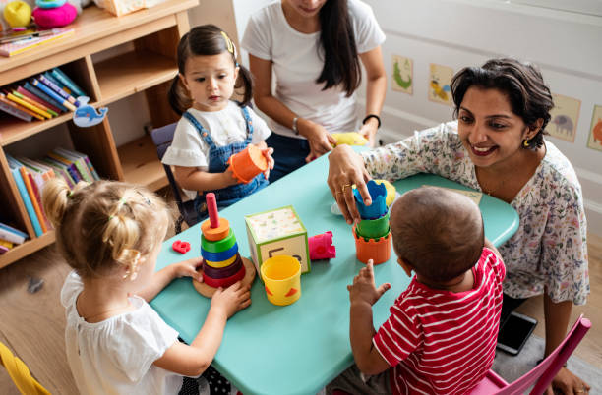
Careers within Bridges: Preschool Support Teacher
The role of a preschool support teacher is the most common within the Bridges program. A preschool support teacher will be working one-on-one with children in the classroom while they complete day-to-day activities appropriate to their age. Some activities that the children participate in are circle time, snacktime/lunchtime, arts and crafts, music and movement, outdoor recess, rest, and free play. Each child is monitored by/works alongside a preschool support teacher at all hours of the school day.

Slide 4
Who I interviewed:
The person that I interviewed for this project was Patricia Terry-Carr; the director of the Bridges preschool in Brewer. As the director of the Brewer Bridges, there is a lot that rests on her shoulders. She is in charge of managing the weekly schedules for the staff and which child they are working with, scheduling tours for parents and children who are planning to attend/are interested in attending Bridges, and even acting as a substitute support teacher if there’s a limited number of staff resent for work that day.

Slide 5
What I learned:
I feel that I learned a lot from this project. It makes me happy to see that there is such a program dedicated to the children who are living with autism. To know that these children are being taken care of, learning valuable life lessons, and getting a quality education in the process is enough to make me smile. It sounds like there are so many hard workers at Bridges and I know that so many children are getting the help they need at such a young age.

Slide 6
Works Cited page
UCP of Maine. (2019, May 17). Early childhood services. UCP of Maine. Retrieved November 27, 2021, from https://ucpofmaine.org/services/early-childhood-services/.
UCP of Maine. UCP of Maine | VolunteerME State of Maine. (n.d.). Retrieved November 22, 2021, from https://volunteermaine.galaxydigital.com/agency/detail/?agency_id=56593.
FatCamera, Limjareon, C., Rawpixel, Nilimage, kali9, Bernardbodo, DGLimages, Lordn, LightFieldStudios, Svetikd, Monkeybusinessimages, AaronAmat, Productions, S. D. I., Wundervisuals, Tatevosian, Y., Reznik, I., Sturti, ChiccoDodiFC, SeventyFour, … Malija. (n.d.). Preschool Pictures, images and stock photos. iStock. Retrieved November 22, 2021, from https://www.istockphoto.com/photos/preschool.

