Slide 1
Community Resource Project
Sarah Hanington
MHR210

Slide 2
Agency chosen: Living Innovations of Bangor
Living Innovations aims to support people with disabilities to live their best lives. This is done in a variety of ways through their many services. There are offices all across the state of Maine, as well as a few other New England states.
Their services:
-Shared living
-Community support
-Job coaching
-Case management
-In-home support for adults
-Children’s services
-Private pay

Slide 3
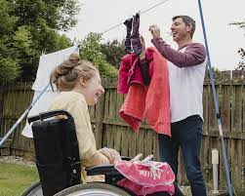
Why are these services important?
Navigating life with a disability is no easy task, especially given the way our society treats those with disabilities. Making friends, making community connections, learning new things, going on adventures and growing as a person are all goals that Living Innovations and other similar agencies strive to help with. Exposing these individuals to community events, opportunities to travel, and other people who want to make friendships makes them feel more connected and important to others, which is a basic human desire. Many times, those with disabilities lack control over their lives and don’t get much say in decision making. Ensuring that they have autonomy and freedom while still being supported is why these services are so crucial.

Slide 4
My experience with Living Innovations
I am currently employed through Living Innovations, and I work as a Behavioral Health Professional (BHP). This means that I work with children with intellectual disabilities to help them reach goals and live more independent lives. I really enjoy my job and have gained so much valuable experience in the year that I’ve been working here. There are a variety of positions at Living Innovations, so I was curious to learn more about other roles that people have. I have chosen to look into what is called the community program to learn about what other opportunities are available through this agency and the field in general.

Slide 5
Interview
I was able to interview a woman named Jennifer at Living Innovations who works in the community program to get some insight. She works with multiple adults with different disabilities, playing games and learning things in the common room as well as going out together in her car to different places. “Sometimes we go to the park for a picnic, sometimes we go to stores to look around or shop, and sometimes we go on the walking trails in the city forest.” There is one “staff” per two or three individuals, and as Jennifer said “It can get a little overwhelming trying to accommodate to everyone’s needs, but once you get to know the people it is so rewarding. It is cool to see how they interact with each other too, and you get a feel for the relationships amongst them over time.”

Slide 6
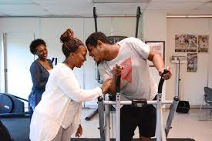
Summary of knowledge gained
Based on the conversation than Jennifer and I had, I can tell that it is a very flexible and adaptive job that really depends on the individuals you are working with. The goal for this program is to ensure clients get to do the things that make them happy, and make friendships and connections on the way. It would definitely be interesting to see multiple different people of different ages, backgrounds, disabilities and interests all in the same room together. It must be great for them to get that feeling of kinship with one another, and get to go out in the community to do the things they like. I would’ve imagined that the staff and individuals were not as close as they would be in a BHP/DSP setting where they are focused in the home, but still being together every day and going on those small adventures keeps the bond tight.

Slide 7
Living Innovations Contact Information
https://livinginnovations.com/overview-of-services/
Bangor Office:
Address: 444 Stillwater Ave #208, Bangor, ME 04401
Phone: (207) 992-2700

