Slide 1
Stellisha Thomas
COE 313

Slide 2
Master of Science – Clinical Mental Health Counseling
Location: 2400 North Charles Street in Baltimore, Maryland
Phone Number: (410)516- 8000
Admissions (Graduate School)
https://e-catalogue.jhu.edu/education/programs/masters/counseling-master-science/

Slide 3
Requirements / Applications:
The timeline for submitting an application for Fall 2022 is Feb. 15th, 2022.
The application fee for this degree is $80.00.
The credits required are about 60 credits.
Classes are offered online or can be taken in person.
A bachelor’s degree is required from an accreditied college or university.
A minimum cumulative grade point average of 3.0 (on a 4.0 scale).
If GPA scores are below 3.0, a GRE is required.
Two letters of recommandation are required.
A personal essay is required.
Resume / CV.

Slide 4
Tuition / Accreditation
The program is accredited by the Council for Accreditation of Counseling & Related Educational Programs (CACREP), a specialized accrediting body recognized by the Council for Higher Education Accreditation (CHEA).
Part-Time (Face-to-face/Lecture courses - Counseling) is about $891 per credit.
Online courses (Counseling and DALET) is about $944 per credit.

Slide 5
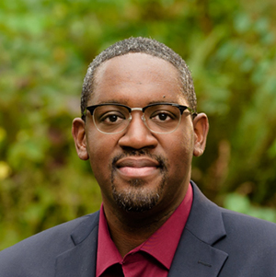
Nathaniel Brown, PhD Lecturer
Dr. Nathaniel Brown is a Lecturer of clinical mental health counseling at the Johns Hopkins University School of Education.
He teaches graduate students in the Counseling master’s degree program, with a focus on clinical mental health counseling.
His research interests include college mental health counseling of students who experienced foster care, counseling theoretical orientation development, HIV/AIDS support groups, foster care postsecondary education transition, retention, and completion.

Slide 6
What is the job market for this job with this degree?
There are many jobs offered with this degree, however, I’ll just name a few:
Social worker
Substance Abuse & Behavior Disorder Counselor
Sports Counselor
Military Personnel
Rehabilitation Counselors
The pay for this job is $47,660 per year & is expected to increase by 25%.

Slide 7
Work Sited Page:
https://e-catalogue.jhu.edu/education/programs/masters/counseling-master-science/#learningoutcomestext
https://education.jhu.edu/academics/ms_counseling/#programplan

