Slide 1
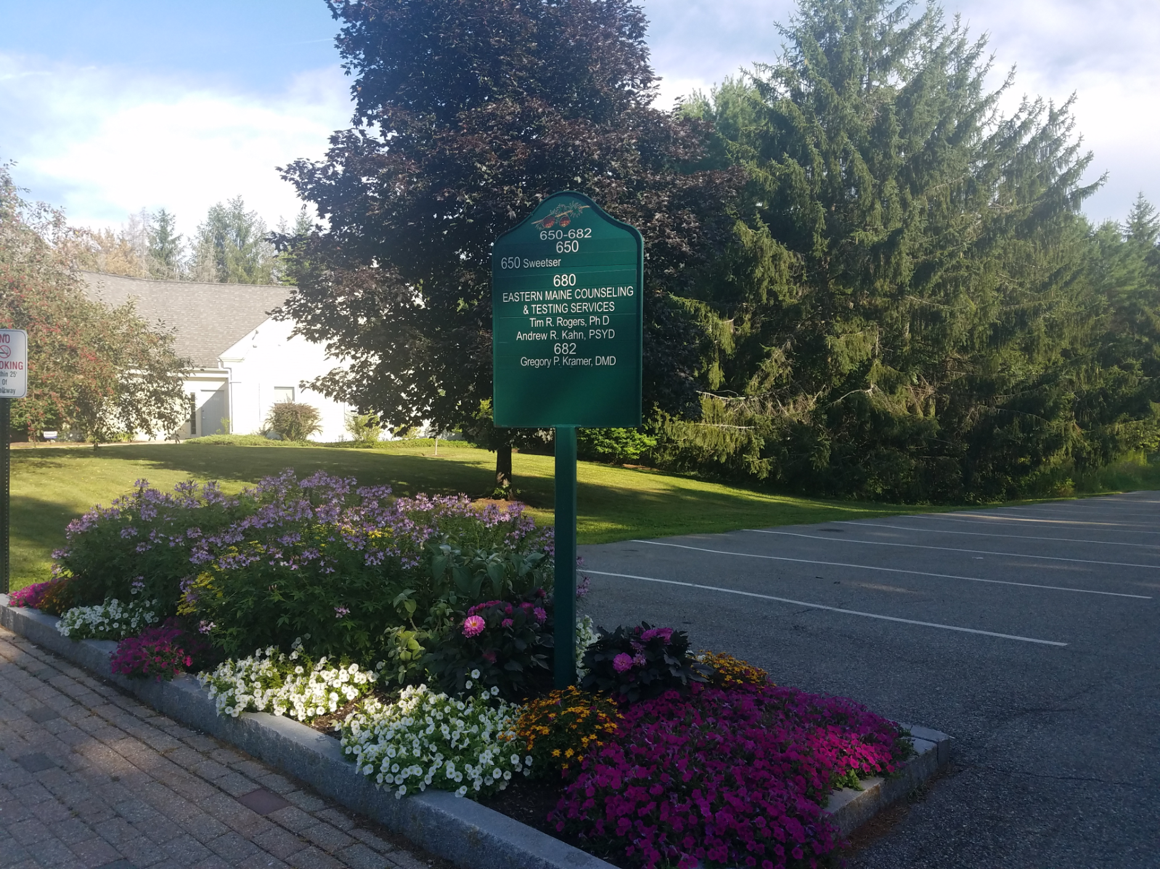
Eastern Maine Counseling and Testing Services
Located 700 Mt Hope Ave., Suite 680 Bangor, Maine 04401
Provides services towards children experiencing developmental, educational, or mental health challenges through Section 28 Program

Slide 2
EMCTS Team
For Psychological Services 5 certified Psychologists, a licensed Psychological Examiner, Board Certified Behavior Analys.
The Administration Team for Section 28 in home services is ran by a separate Board Certified Behavior Analyst, and an Assistant Program Coordinator.
Section 28 program offers services to 11 different families in the area, through the use of Behavioral Health Professionals (BHP). BHP are required to go through a training program to apprehend the title and continue services.

Slide 3
Behavioral Health Professionals
10 BHPs currently reside in the Section 28 home program, ideally the program would include 15-20.
Reasons for why the agency is understaffed are most likely related to the fact hours are part time and there aren't any extra benefits with the job.
This profession is usually employed by college students, as it fits in as a temporary job.
EMCTS post flyers, take referrals, hold an advertisement on both Husson and Umaine career link, along with also Indeed.com

Slide 4
Rapport
A huge goal of Section 28's BCBA is for families to feel comfortable with the agency, so that they won't feel hesitant asking for help.
Every client's family has a team meeting each month to check up on how services are going, which is ran by the BCBA. New points may be added onto the treatment plan, or taken off if no longer an issue.
The programs BCBA is also constantly on call for both employees and families incase extra help is needed, not strictly for emergencies.

Slide 5
Family Selection
The state of Maine holds a waitlist for Section 28 services. Section 28 actually has two services, Specialized and Basic, EMCTS offers specialized services.
The department of Human Health and Services holds the waitlist
If a child receives a doctors diagnosis of a special disability, then they can go to a service provider to be placed on the waitlist. Families can choose a specific agency to work with, or general waitlist which would go to first available agency.
Servies are offered to families within approximately 40 miles from the Bangor area

