Slide 1
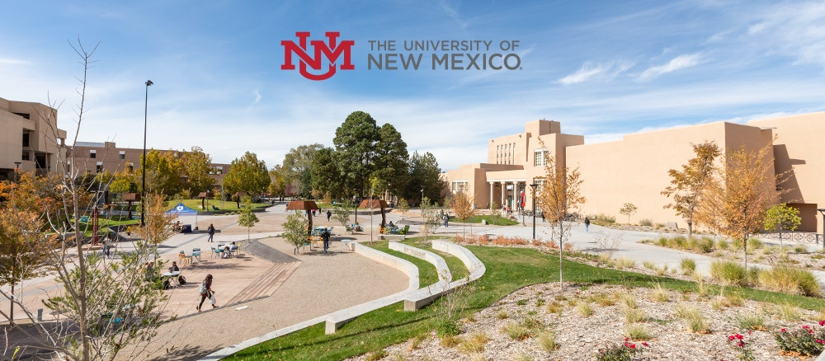

Counseling education degrees
By Christina Ingemi for COE-313 fall 2021

Slide 2

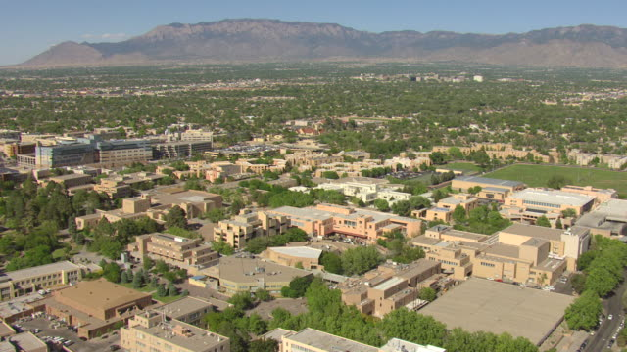
University of New Mexico information
Tuition
Tuition for NM residents is $336.12/credit hour
Tuition non-residents is $1,078.54/credit hour until you reach 12-18 credit hours, then it’s a block rate of $12,979.26/semester
Albuquerque, NM
https://coehs.unm.edu/departments-programs/ifce/index.html

Slide 3
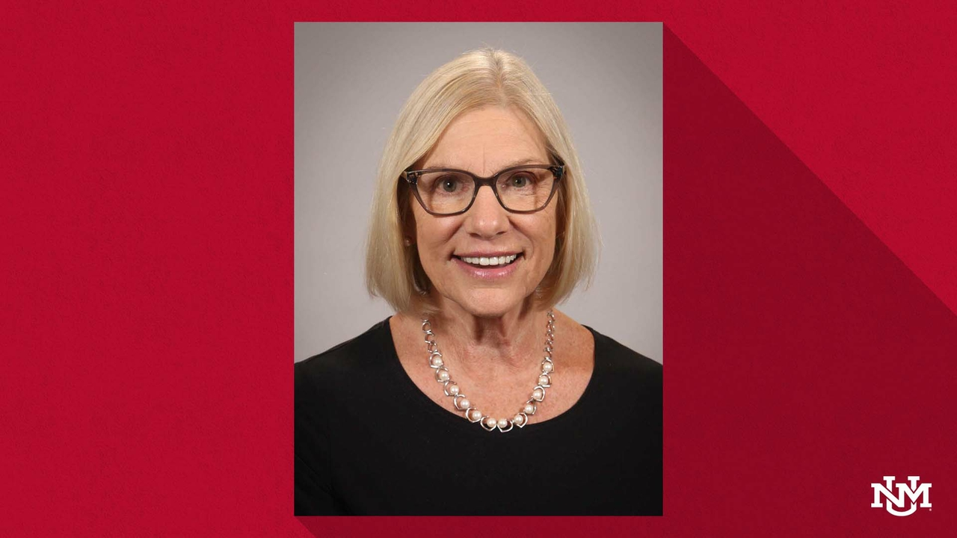
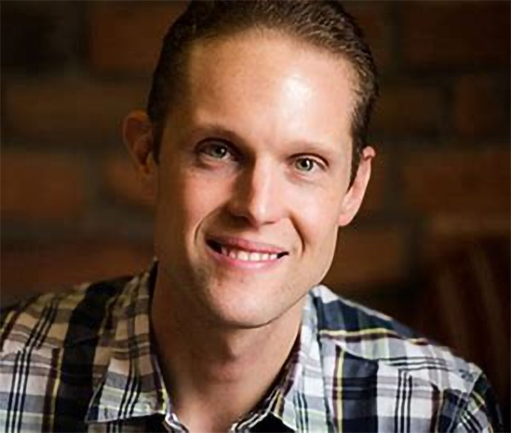
Faculty For Counselor Education
Kristopher Goodrich
Professor
Chair of the Department of Individual, Family, and Community Education
Office Location: Simpson Hall, Room 129
Phone: (505) 277-7222
Email: kgoodric@unm.edu
Research & Scholarly Interests
LGBTQQIA Issues in Professional Counseling and Counselor Education
Counselor Education Pedagogy
Group Work in Counseling
Deborah Rifenbary
Associate Professor
Retired
Phone: (505) 277-8933
Email: riffer@unm.edu
Research Interests:
International education
School counselor role and responsibilities
Workforce development
Career-technical education
Notes:
College of Education and Human Sciences
Individual, Family, and Community Education
Graduate Faculty Contact:Jean Keim
Staff Advisor:Cynthia Salas

Slide 4

Application timeline
Degree Information
This degree is 60 credits which takes about 3 years
The program is accredited by the Council for Accreditation of Counseling and Related Educational Programs (CACREP)
As of 2019, all were traditional in-person classes
Admission Requirements
Academically have a bachelor’s degree, 3.0 GPA, and 18 credits of upper-level courses (300-400 level or graduate classes)
University and Program Application forms
Three letters of recommendation are required
Letter of Intent/Personal Statement (3 pages maximum) that includes a cultural competence aspect and relevant experience
Transcripts
In person interview
Does not require GRE or MAT scores
There is an application fee of $50
Master’s Degree
Fall: January 15th
Spring: August 15th
Doctorate Degree
Applications are accepted on an ongoing basis and reviewed monthly by program faculty
Notes:
IN the Individual, Family, and Community Education department, The University of New Mexico has both a Master’s degree program and a PhD doctorate program.
It has a Masters of Arts in Counseling and a PhD in Counselor Education. They also how a Masters of Arts in School Counseling, which can be combined with the Counseling degree in a 4 year program. The application timeline for is… but they say to get stuff in 2 weeks ahead of time. This degree info focuses on the Masters in Counseling degree.

Slide 5
projected to grow 23 percent from 2020 to 2030, much faster than the average for all occupations
About 41,000 JOB openings are projected each year, on average, over the next decade
$47,660 per year
$22.91 per hour
Information from: https://www.bls.gov/ooh/community-and-social-service/substance-abuse-behavioral-disorder-and-mental-health-counselors.htm
Job Outlook for Substance Use, Behavioral, and Mental Health Counselors
Notes:
Much of the growth due to military returning from aphganistan and now COVID This is for those who work in mental health with either a bachelors or masters.

